Slide 1
Summerprogram and summerproject 2020 in Germany
Wilhelmshaven, summer 2019

Slide 2
cooperation
1987 - 2019
… very intensive with summerprograms and projects since 2012!
2
2
2

Slide 3
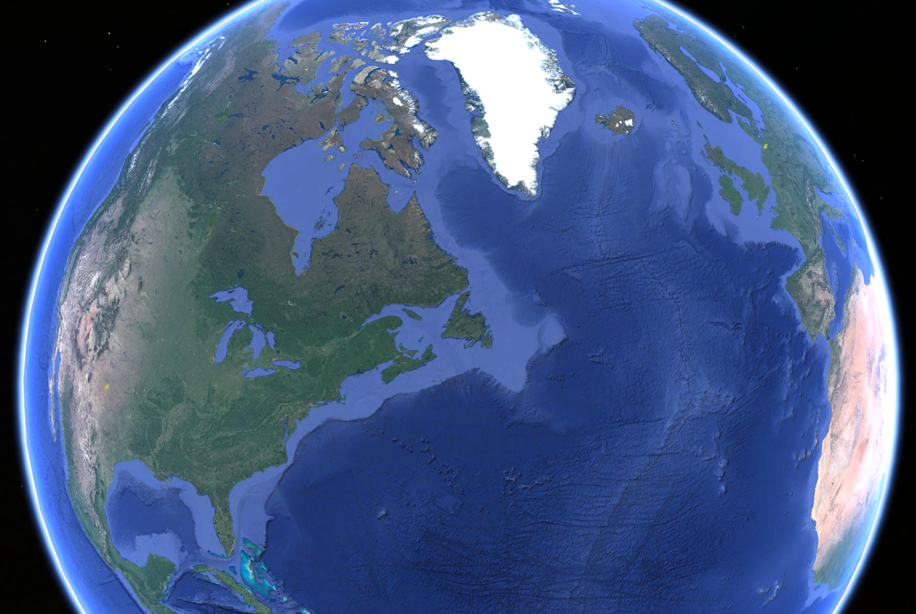
come to Germany
From USA - Texas- Lubbock to Europe - Germany - Wilhelmshaven

Slide 4
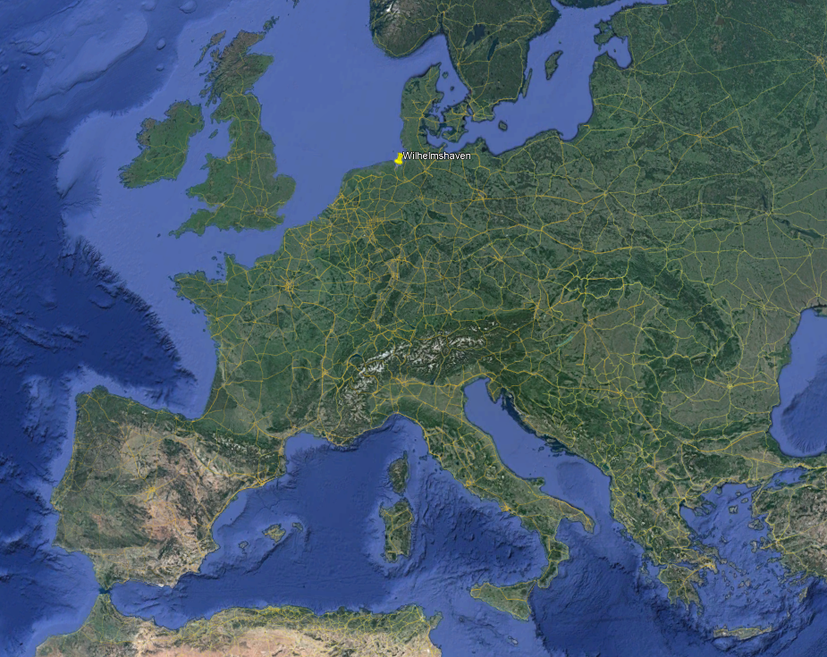
come to Germany
Europe - Germany - Wilhelmshaven

Slide 5
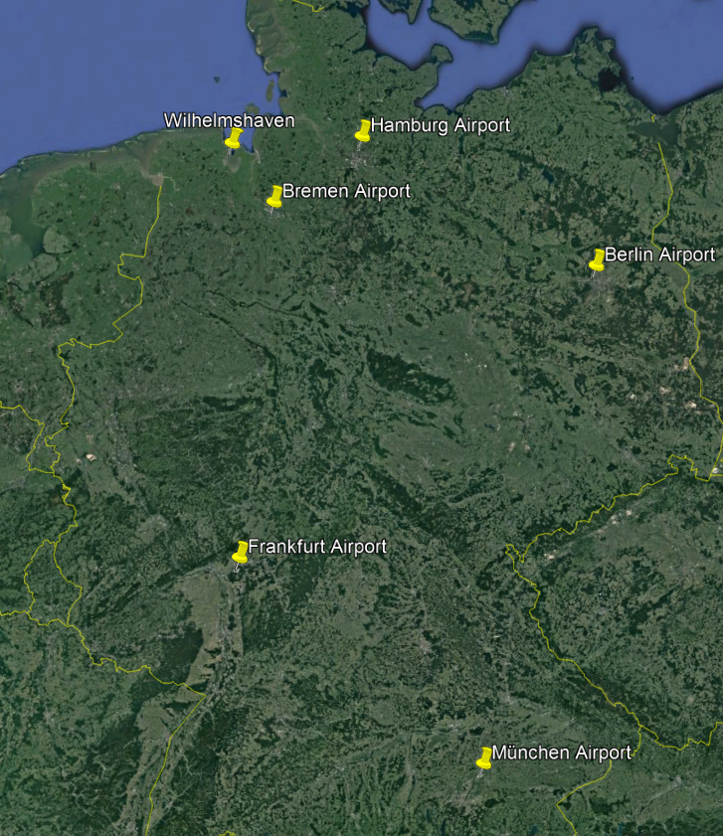
come to Germany
Germany - Wilhelmshaven

Slide 6
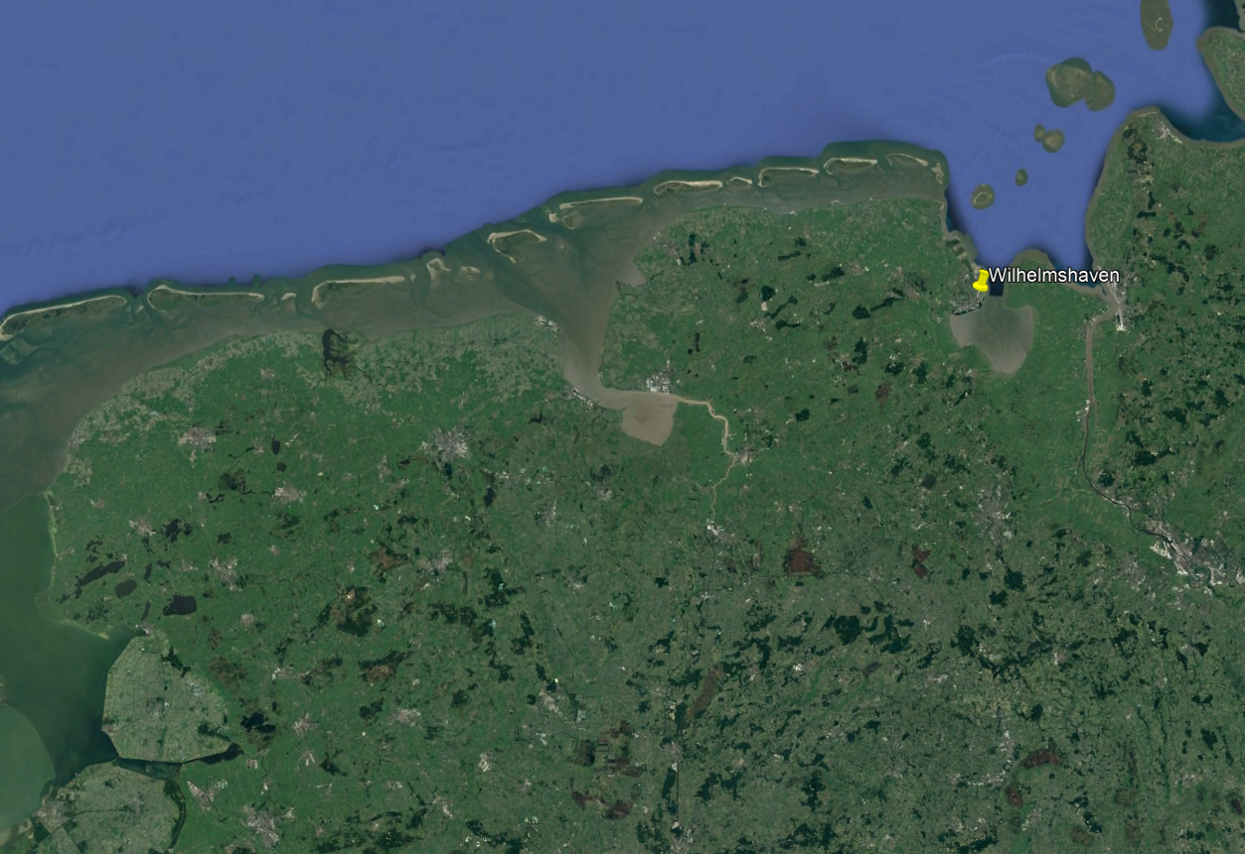
come to Germany
Wilhelmshaven

Slide 7
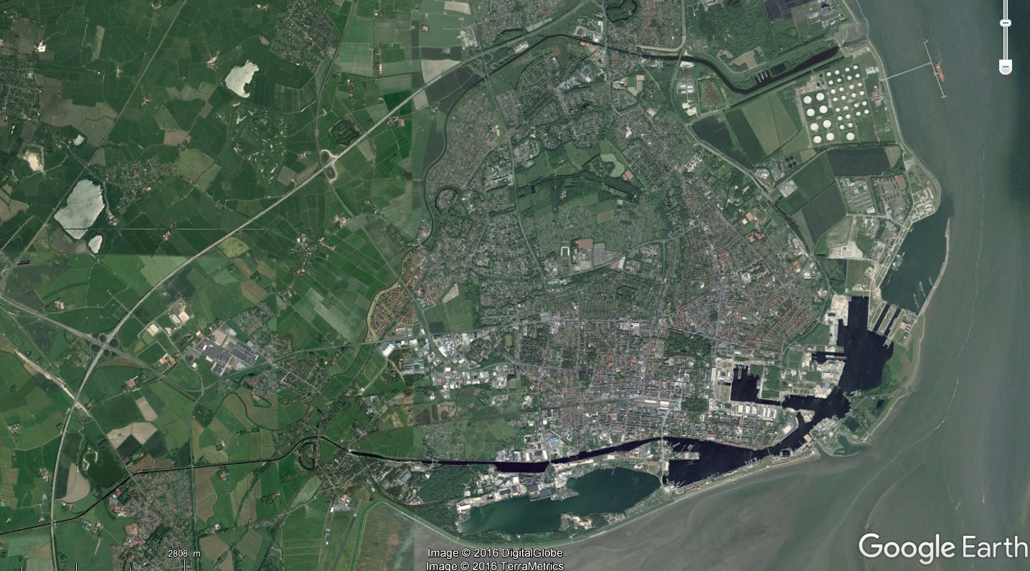
wilhelmshaven
Downtown – Hotel Campus
7
7
7

Slide 8
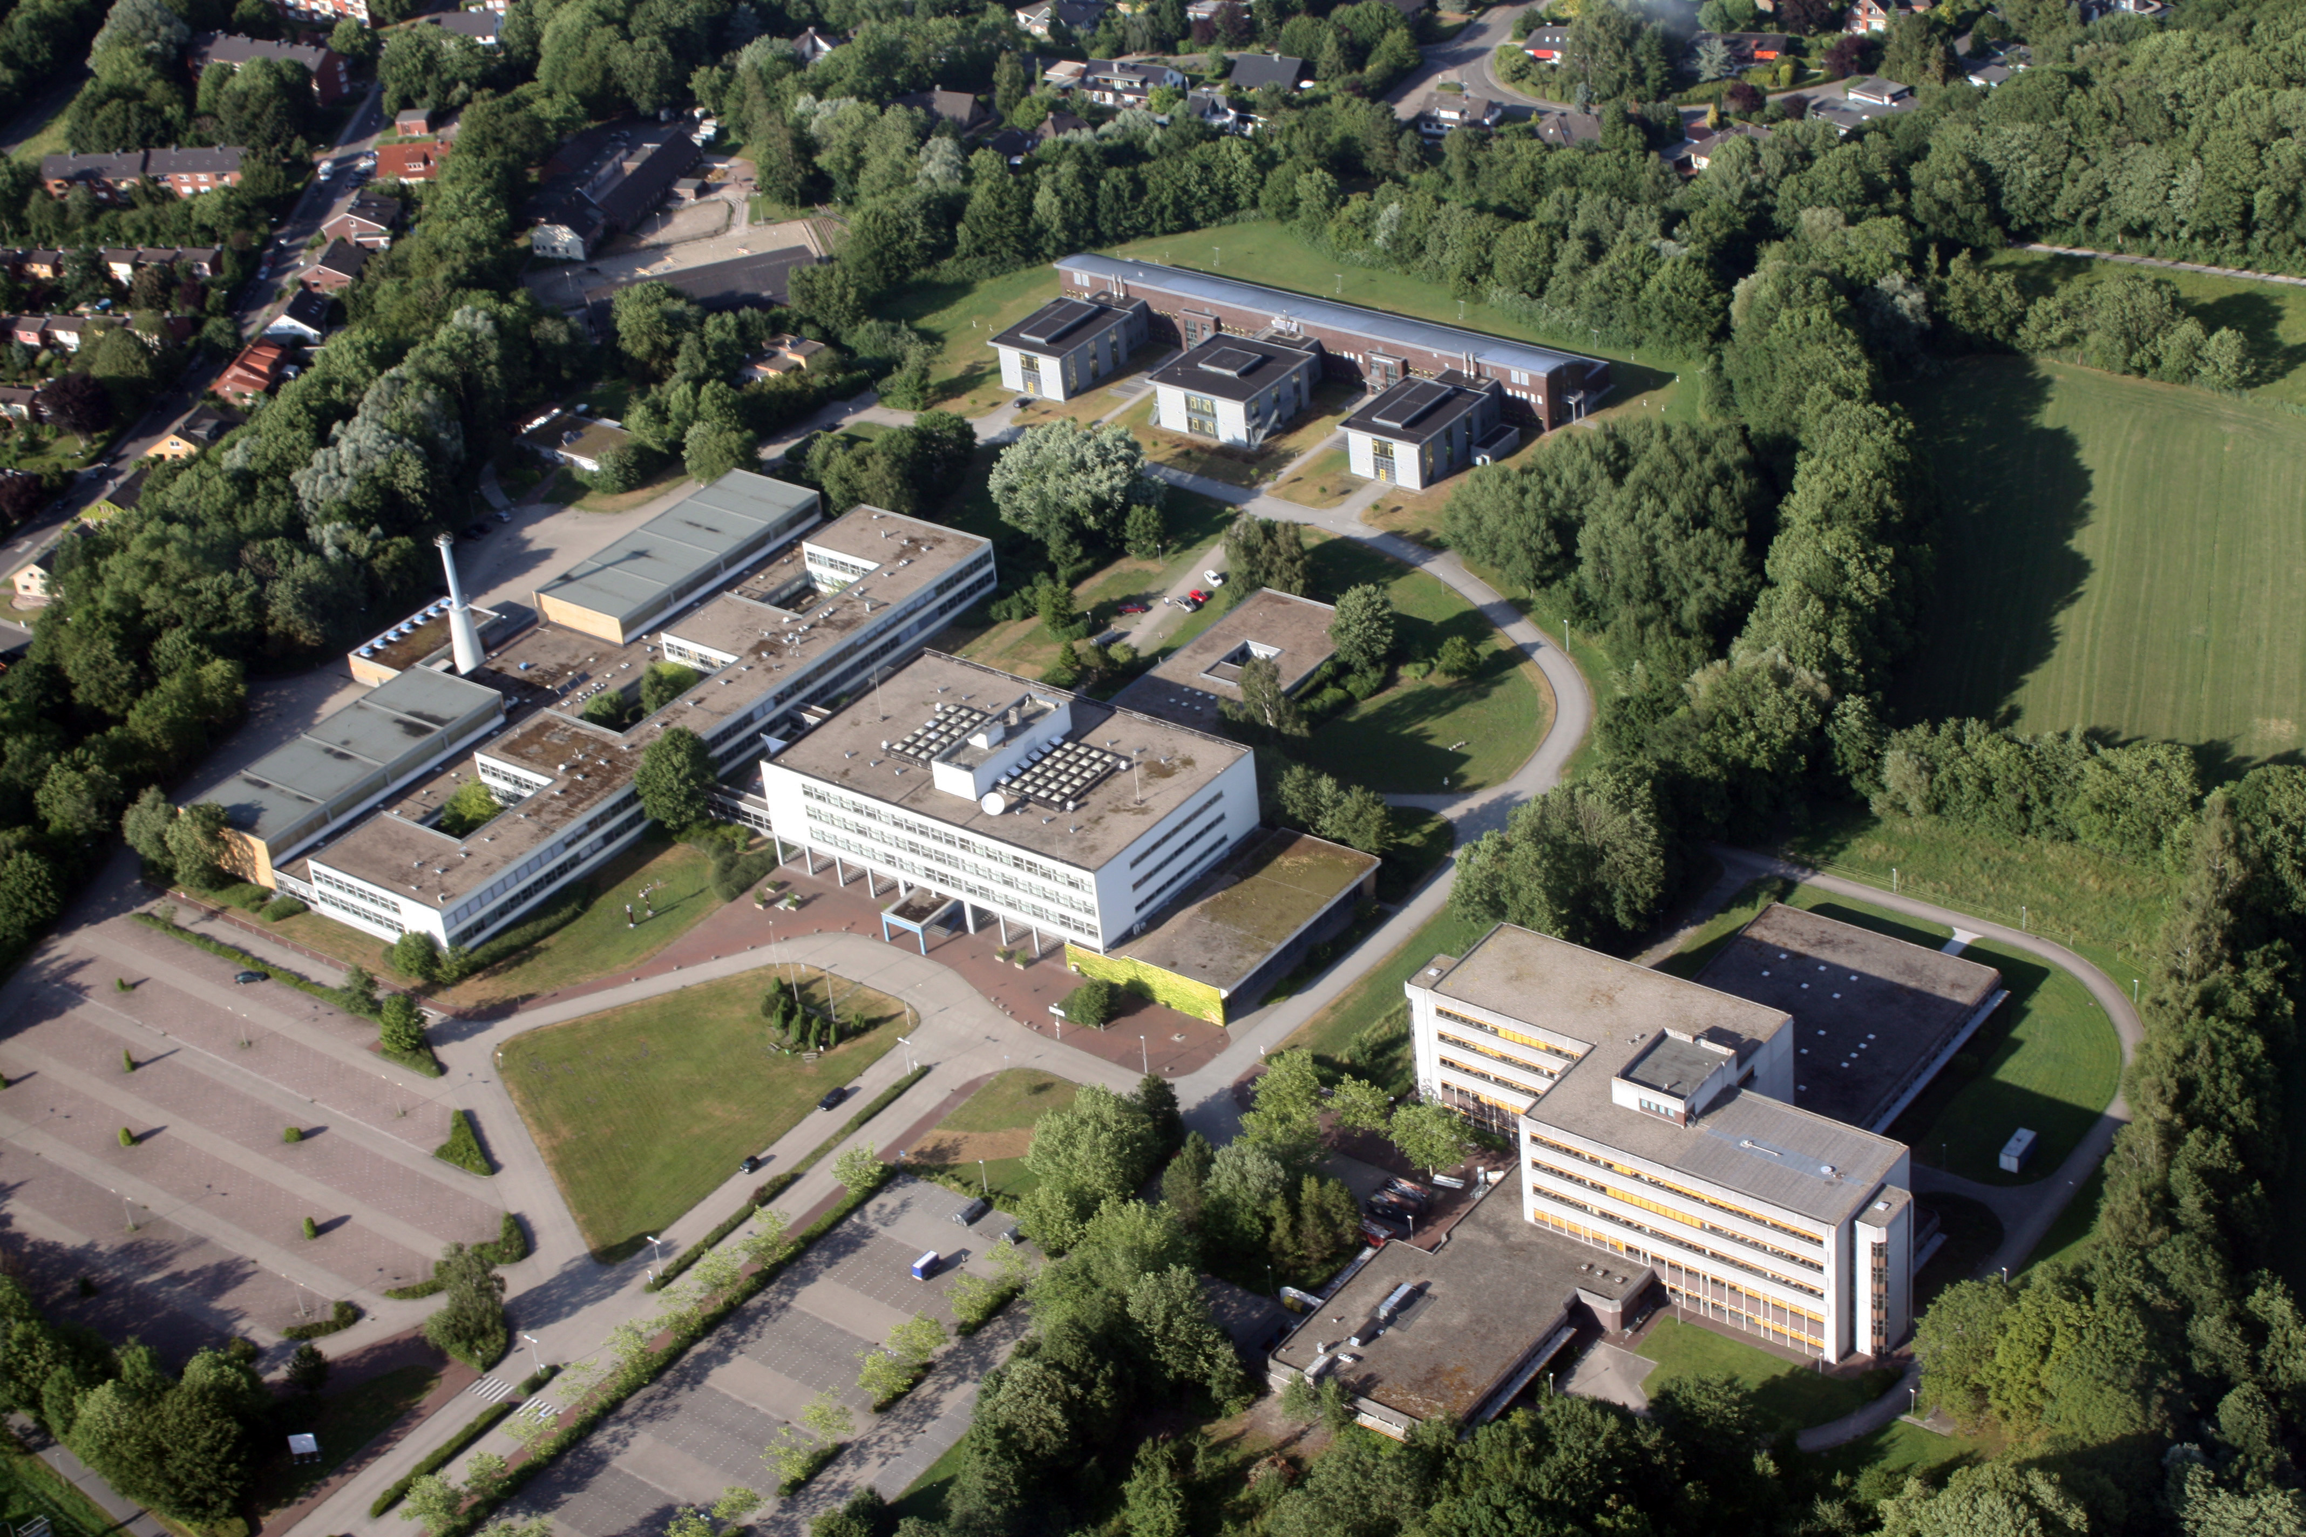
Campus Birdview
www.jade-hs.de
Foto: Lübben
8
8
8

Slide 9
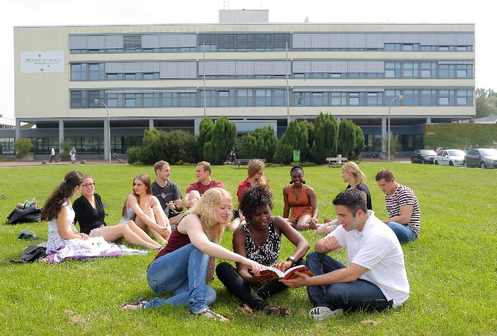
Campus mainbuilding

Slide 10
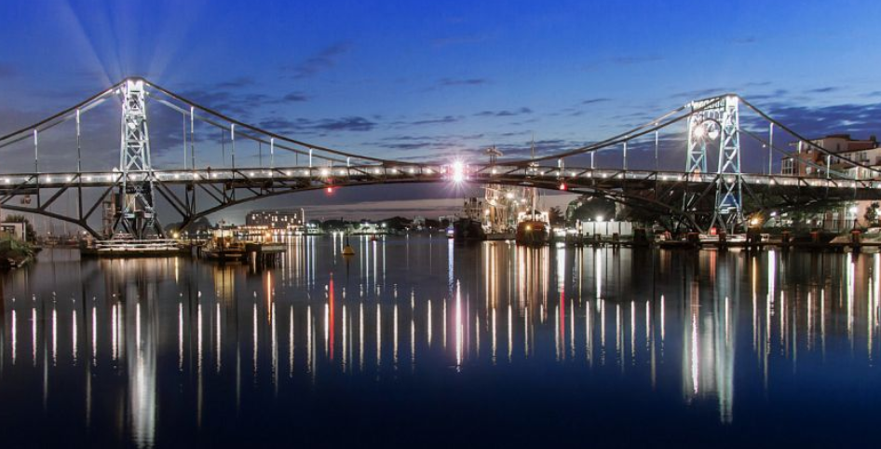
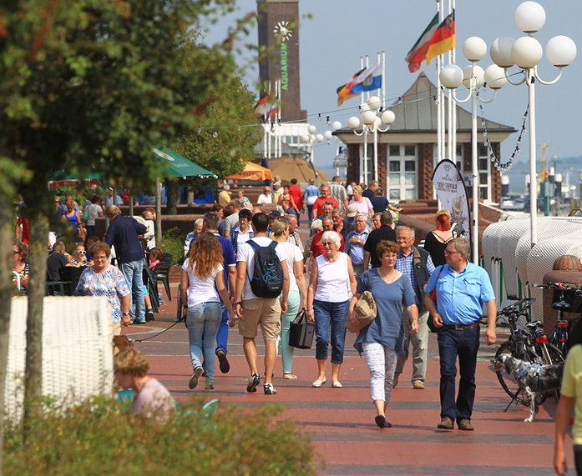
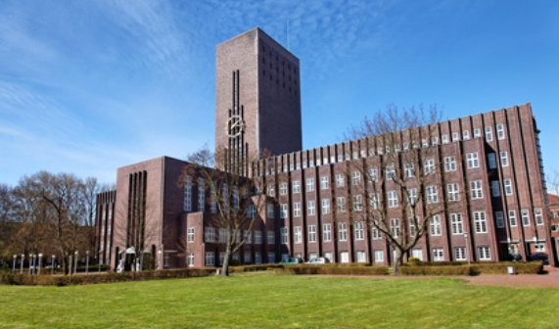
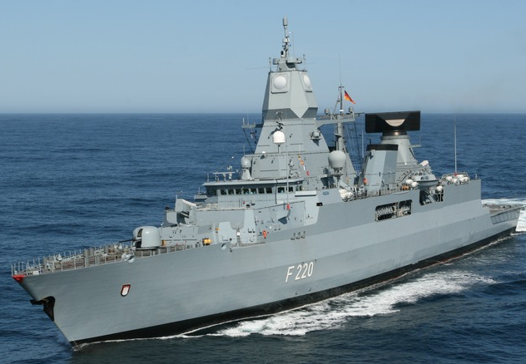
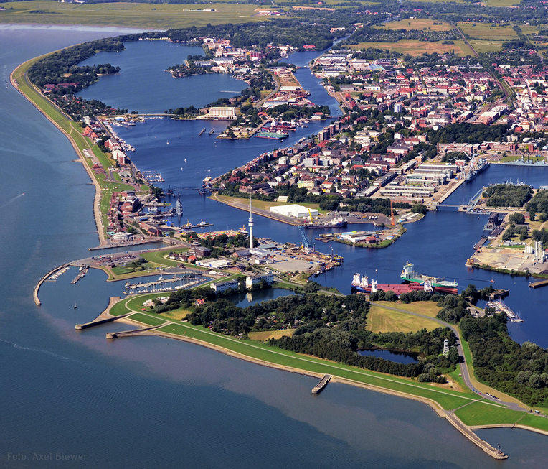
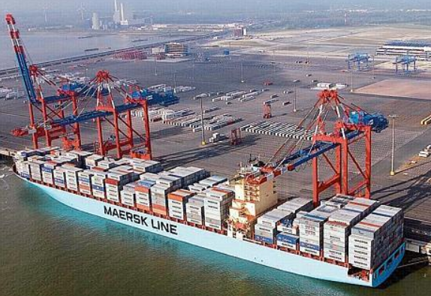
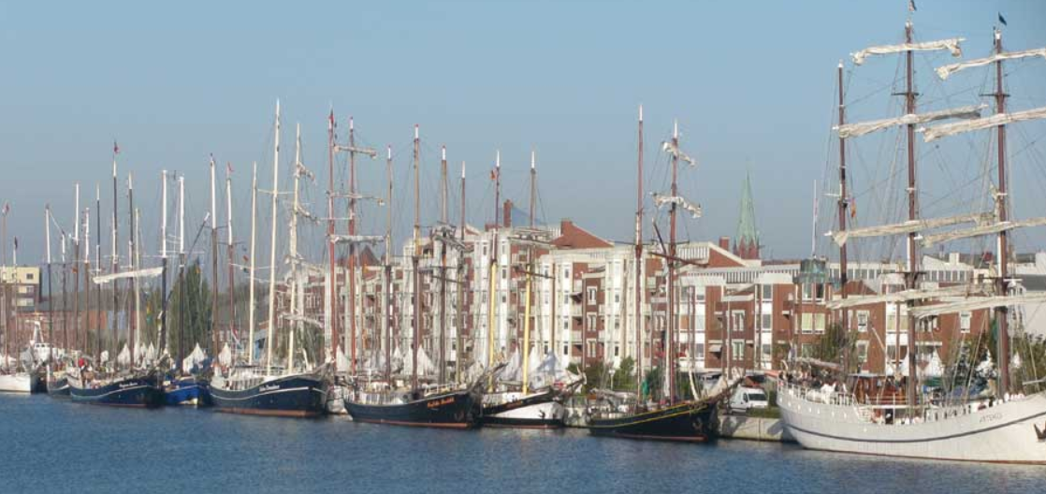
Wilhelmshaven
City at the North Sea
Largest continuous tidal flats in the world!
Lower Saxony Wadden Sea National Park
UNESCO World Heritage since 2009
10
10
10

Slide 11
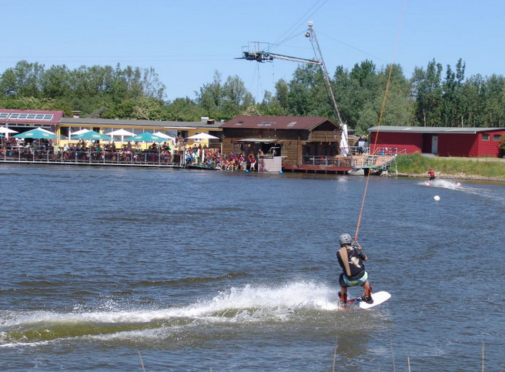
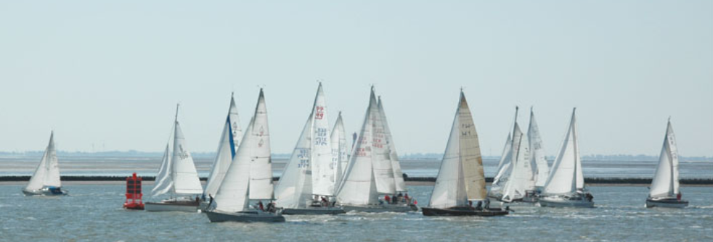
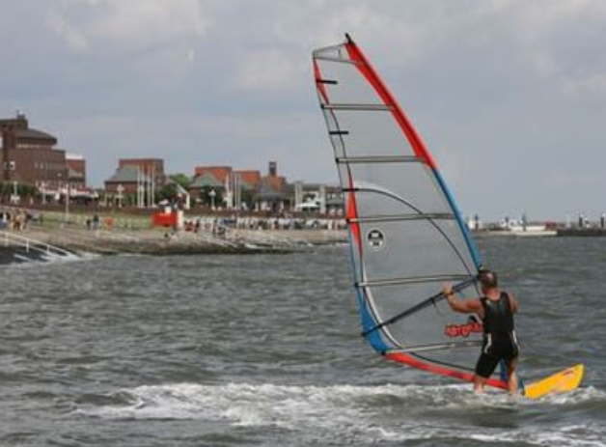
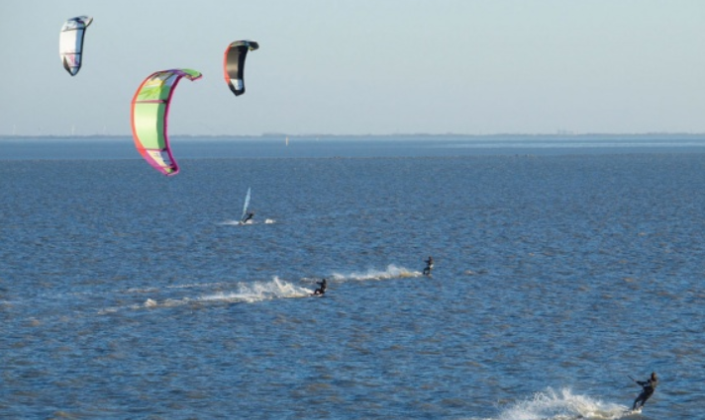
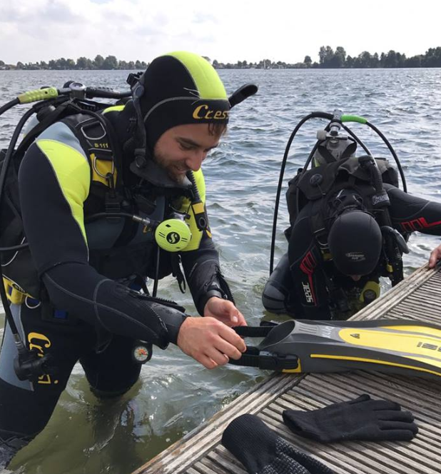
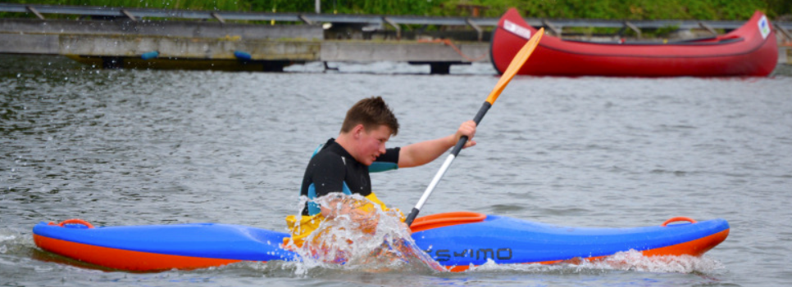
wilhelmshaven
Watersports
Watersports
11
11
11

Slide 12
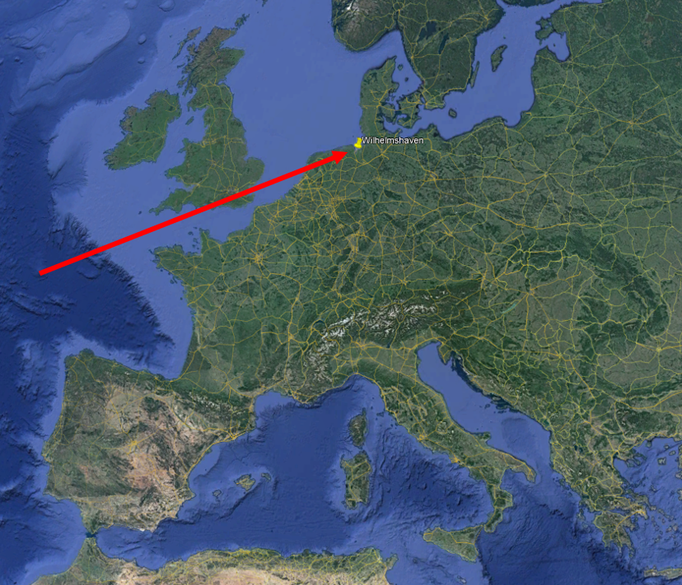
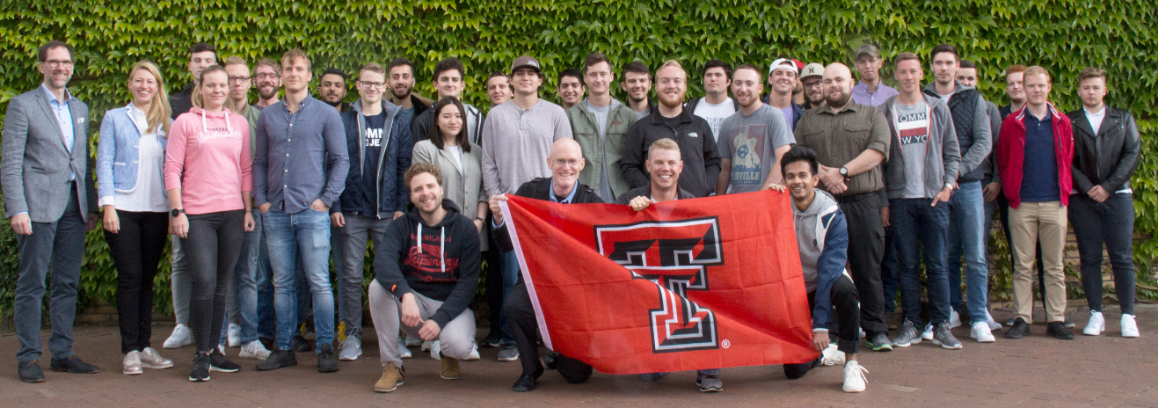
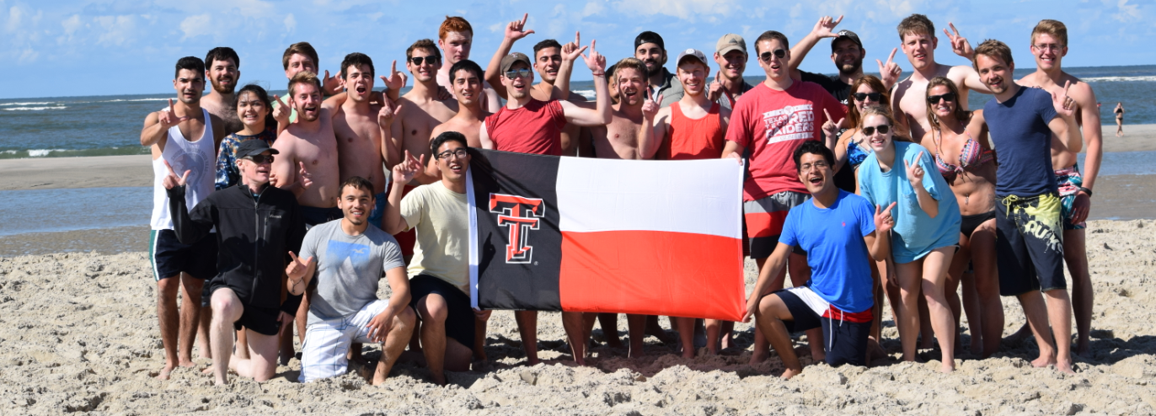
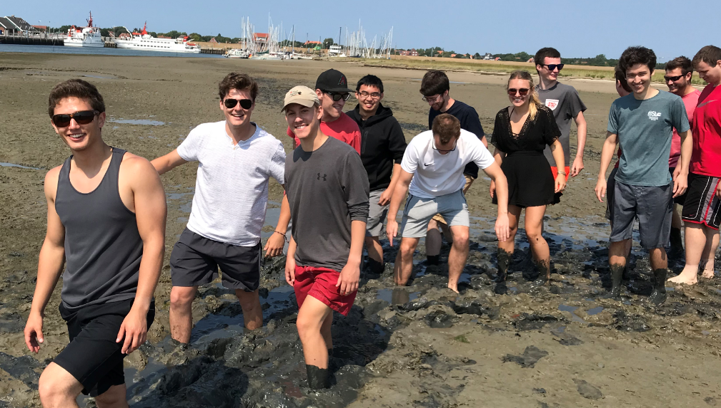
11th Summerprogram 2020 in GERMANY
Cooperation since 1987 – Yearly summerprograms since 2010!
OFFER IN 2020:
6 weeks in Germany at Jade - July 6th to August 16th 2020
3 offered courses:
Circuits 3 cts (TTU ECE 3302???)
theoretical class – learn the theory
PSPICE simulation – simulate the circuits
verify your simulation, measurements in lab
Fluid Mechanics 3 cts (TTU CE 3305)
basic knowledge of technical fluid mechanics
professional analysis of functionality and interaction of practice-relevant fluidic problems
International Engineering 3 cts (TTU ENGR 3301)
Part 1: Intercultural Understanding gain intercultural competencies for global business
Part 2: Innovation Engineering methods of customer-centric innovation engineering
Costs
$2.500 housing & breakfast
$620 program & activities fee
+ TTU fees
Largest continuous tidal flats in the world!
Lower Saxony Wadden Sea National Park
UNESCO World Heritage since 2009
www.jade-hs.de/ttu
12
12
12

Slide 13
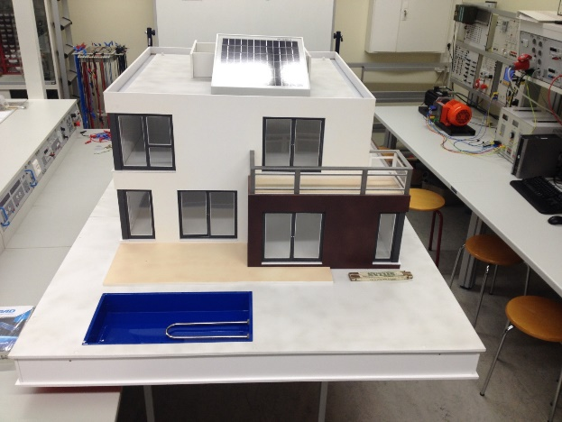
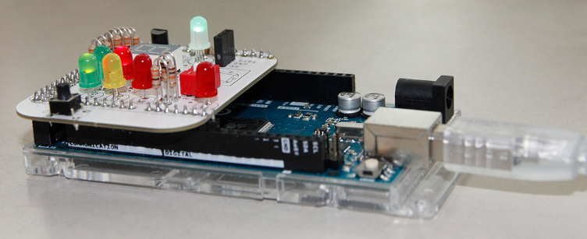
4th SummerproJECT 2020 in GERMANY
Cooperation since 1987 - Summerprojects since 2014
OFFER IN 2020: international smart home project
March – September
6 weeks in Germany at Jade - July 6th to August 16th 2020
2 x 3 cts (3 cts theoretical part, 3 cts practical part)
March/April 2020 Distance work | Grouping Distribution of sub-projects Literature research Web conferences
Summer 2020 TTU students travel to Jade July 6th to August 16th | First personal meetings Preparatory classes Detailed work packages Creating functions Resolving problems Documentation
August/September 2020 Distance work | Solving last problems System tests Documentation
September 2020 Jade students travel to TTU | Finals tests Final presentation at TTU
Largest continuous tidal flats in the world!
Lower Saxony Wadden Sea National Park
UNESCO World Heritage since 2009
Costs
$2.500 housing & breakfast
$ 750 program & activities fee
+ TTU fees
www.jade-hs.de/ttu
13
13
13

Slide 14
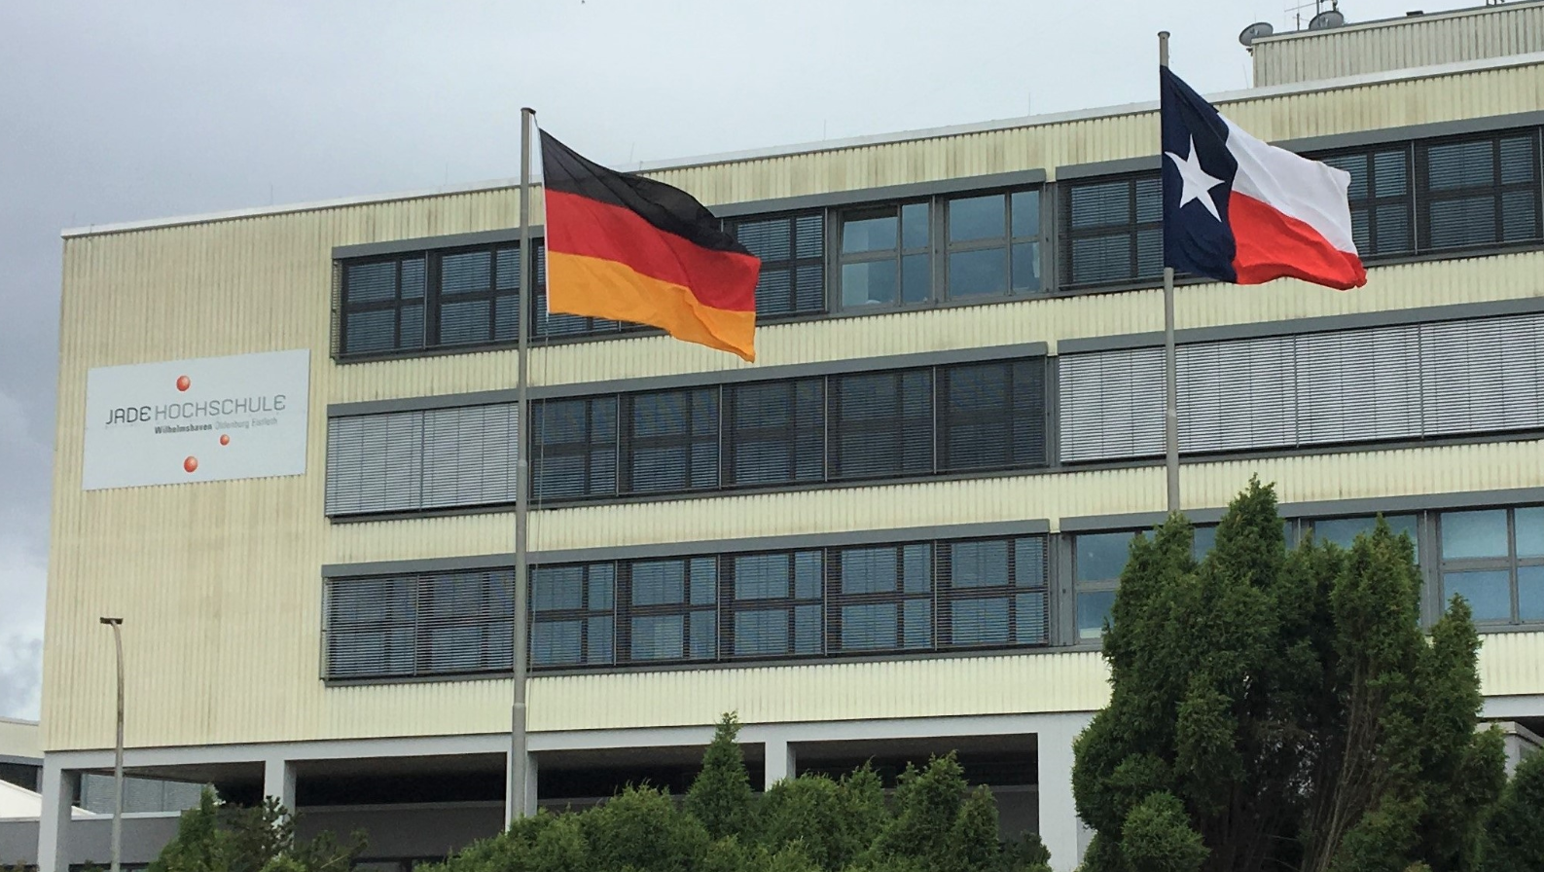
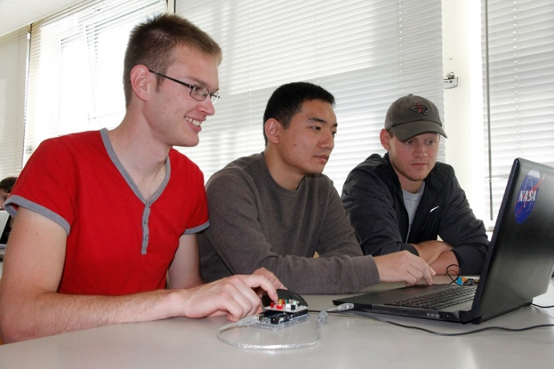
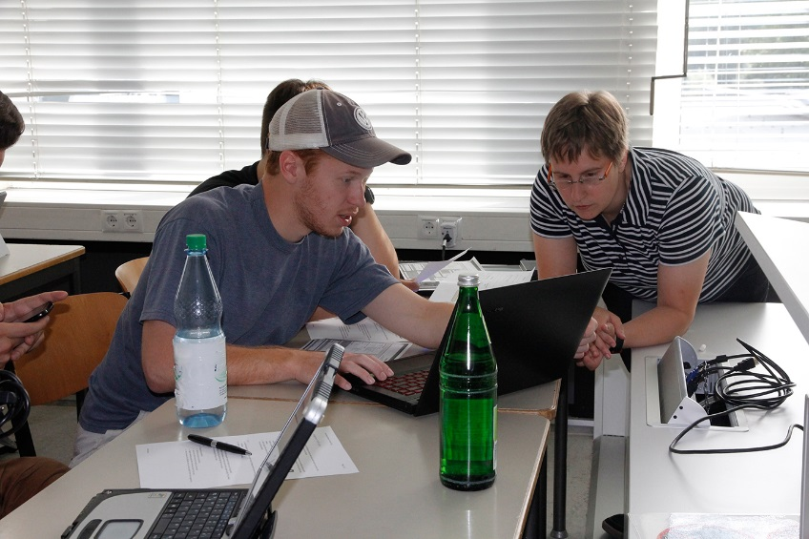
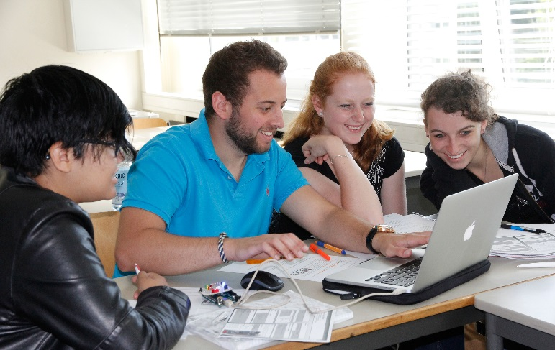
International experience
International experience during group-work in Wilhelmshaven
14
14
14

Slide 15
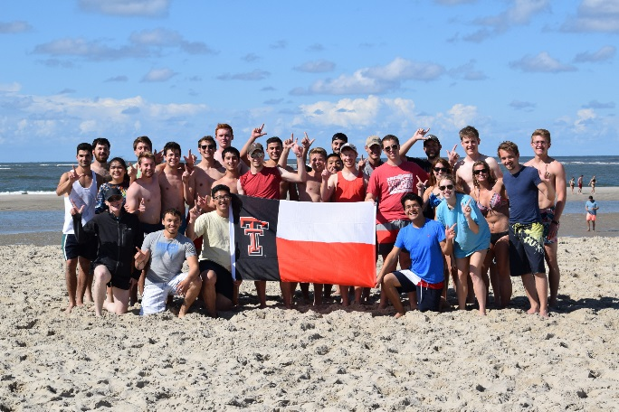
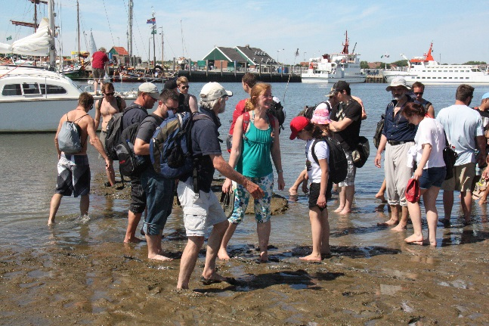
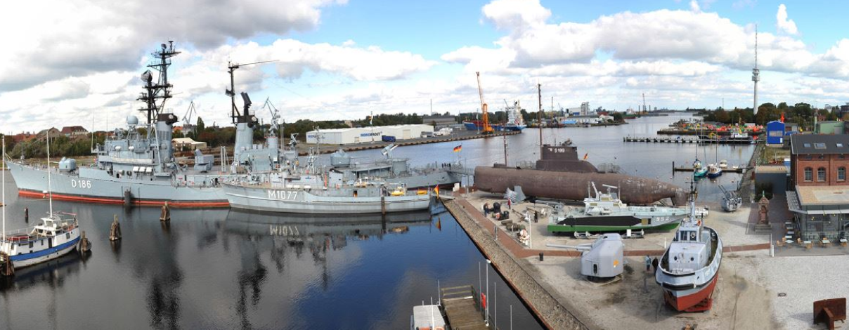
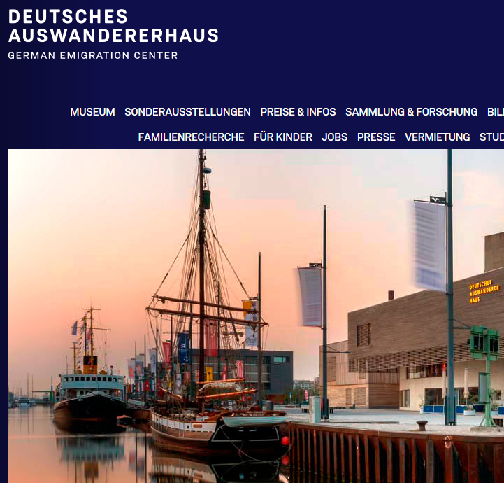
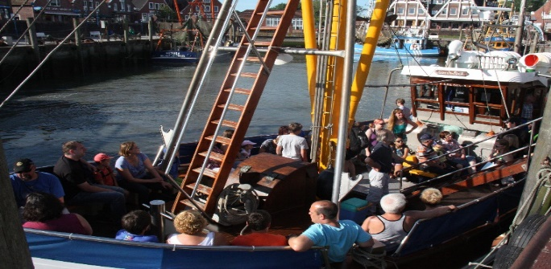
Additional program
Additional program
welcome lunch
guided town walk Wilhelmshaven
sightseeing bus tour Wilhelmshaven
welcome dinner
visit of the German Emigration Center Bremerhaven
volleyball with dinner
Spiekeroog island daytrip - World Heritage Wadden Sea
inner/outer harbor roundtrip
visit of the German Navy museum
final barbeque
Having fun.
15
15
15

Slide 16
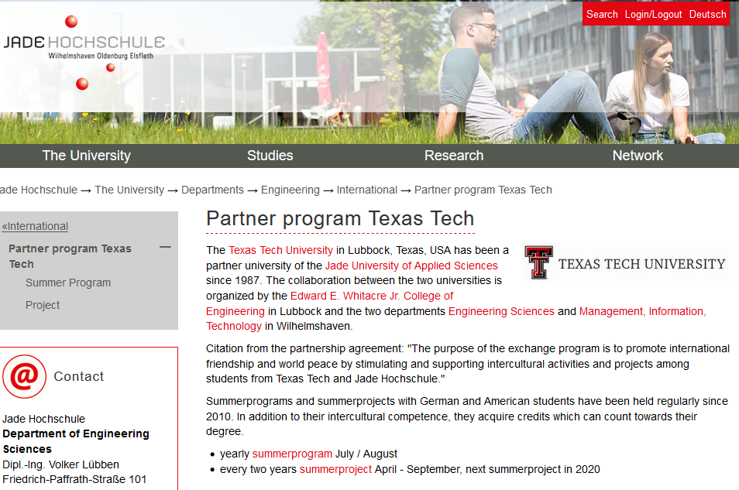
WEBSITE
Visit Germany Wilhelmshaven!
www.jade-hs.de/ttu
16
16
16

