Slide 1
Department of Maritime and Logistics Studies
International Week 24th April 2018
Laurentiu Chiotoroiu

Slide 2
JADE UNIVERSITY - HISTORY
  1832 The Grand Duke Paul-Friedrich-August of Oldenburg founded the Nautical College in Elsfleth
  1972 Integrated into the Univ. of Applied Sciences Oldenburg
  1992 Start of a new „Maritime & Port Economics“ degree course
  2000 Fusion of Applied Sciences Uni’s in the Northwest DE (10,000 students in 5 locations)
  Reestablishment of the Jade University in 3 locations
  2016 Renaming the department
Notes:
So what kind of Campus are you entering today? The Dept. Of Maritime Studies is one of the oldest maritime school in Germany. It was founded …

Slide 3
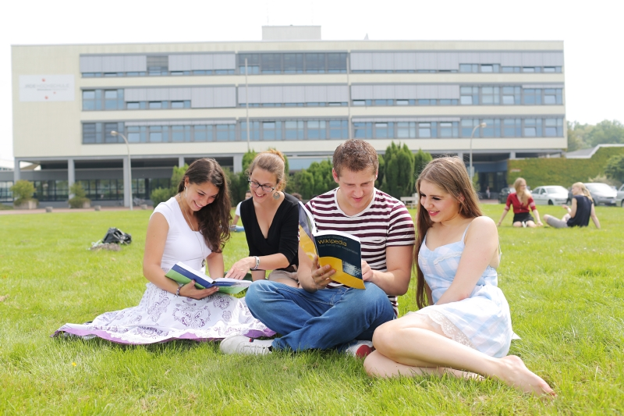
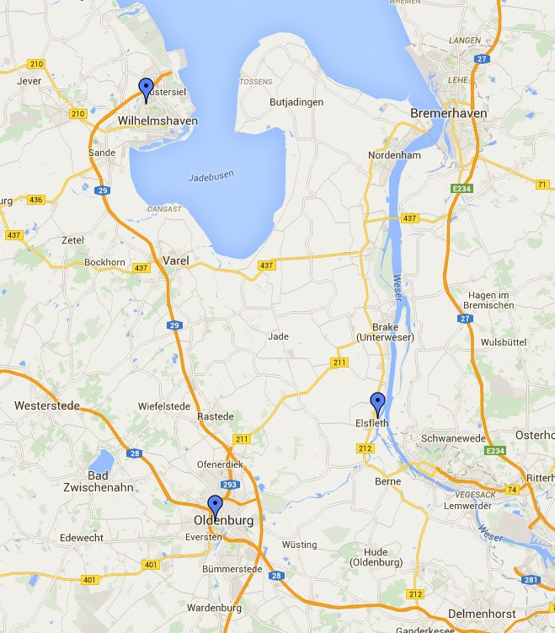
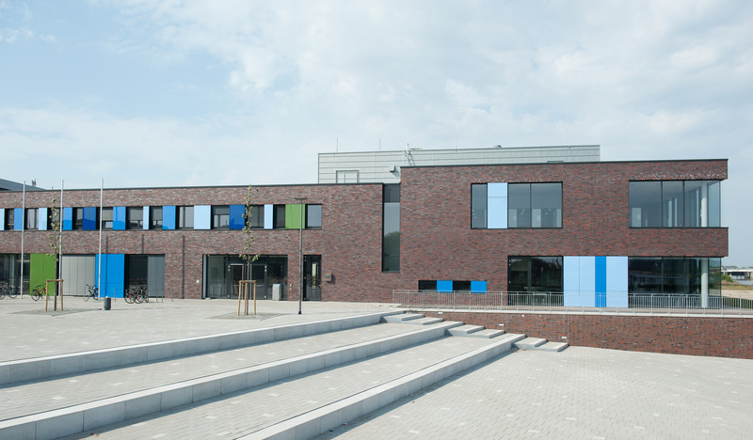
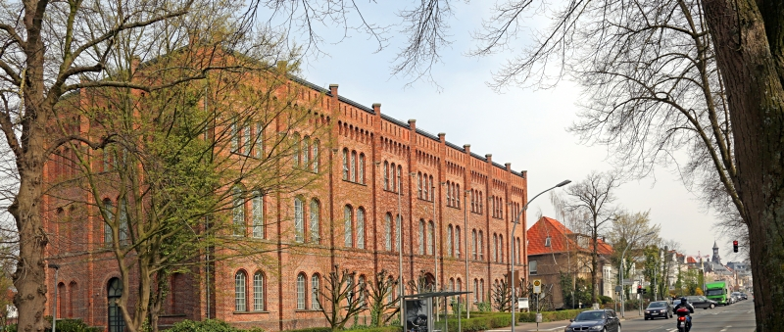
JADE UNIVERSITY – CAMPUSES LOCATION
Dept. of Business Administration and Management
Dept. Management Information and Technology
Dept. of Engineering Sciences
Dept. of Maritime and Logistics Studies
4,800
students
650
students
2,100
students
Dept. of Architecture
Dept. of Civil Engineering, Geo-information and Health Technology

Slide 4
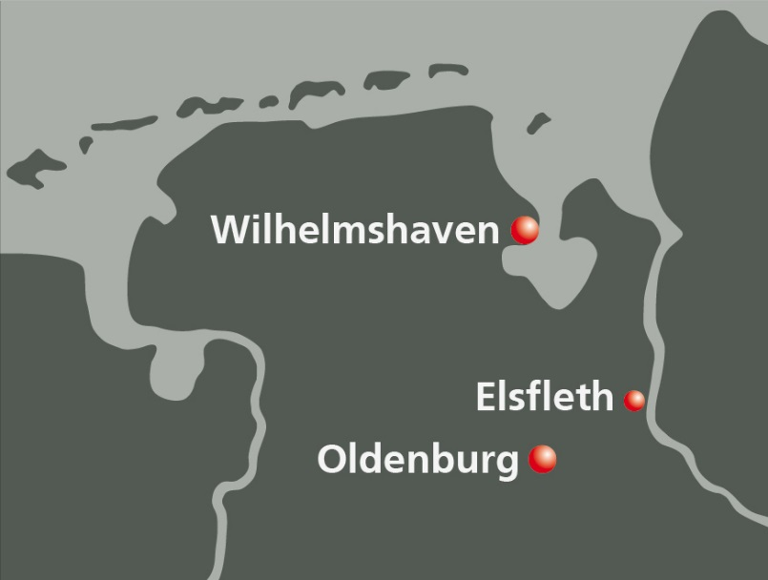
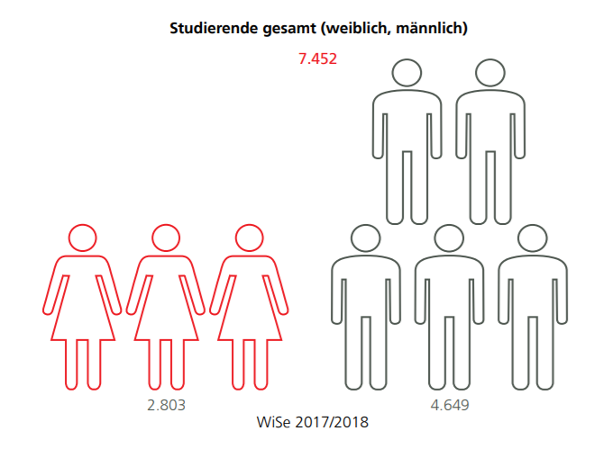
JADE UNIVERSITY - FACTS AND FIGURES
3 campuses
6 departments
7,452 total number of students
38 Bachelor-courses
12 Master-courses
500 number of employees
200 number of professors
90 partnerships/foreign
contacts (in 30 countries)

Slide 5
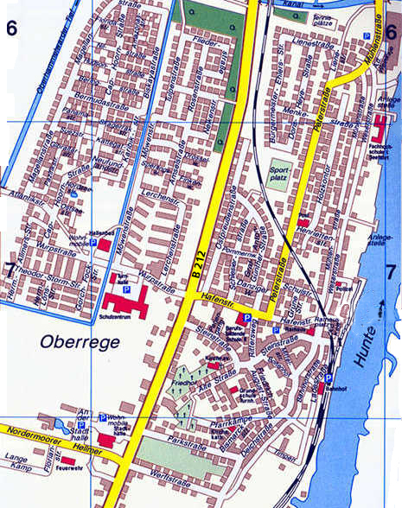
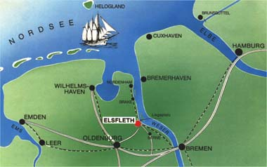
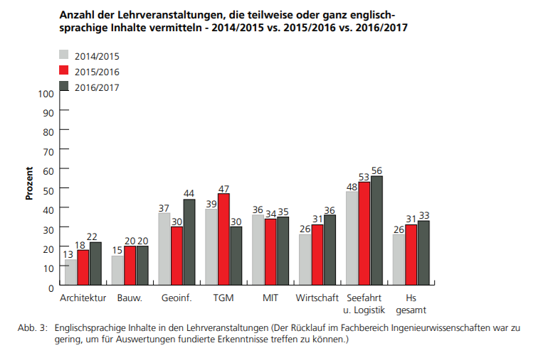
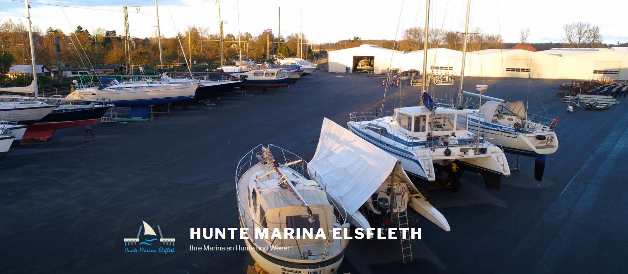
STUDY SITE ELSFLETH
WHY STUDY IN ELSFLETH?
People know each other and new arrivals are quickly integrated into the student body;
Direct and close contact between students and teaching staff, during and after classes;
Attractive range of courses offered;
Possibility to studying abroad – approx. 2/3 of students integrate a semester at a foreign university into their studies;
Latest technical equipment and state-of-the art simulators;
Increased nr. of lectures taught in English
Existence of a training ship
Population of only 10,000
Very connected with seafaring and port economics
Location of 3 ship-owners companies
City with a maritime flair
Starting with 1832, here is the location of one of the biggest maritime university in Western Europe
Some of our colleafgues and the seafarers living in Elsfleth keep their boats in a Marina
Close contacts with business - good links with industry -90% of graduates move directly on to relevant jobs;
Low cost of living;

Slide 6
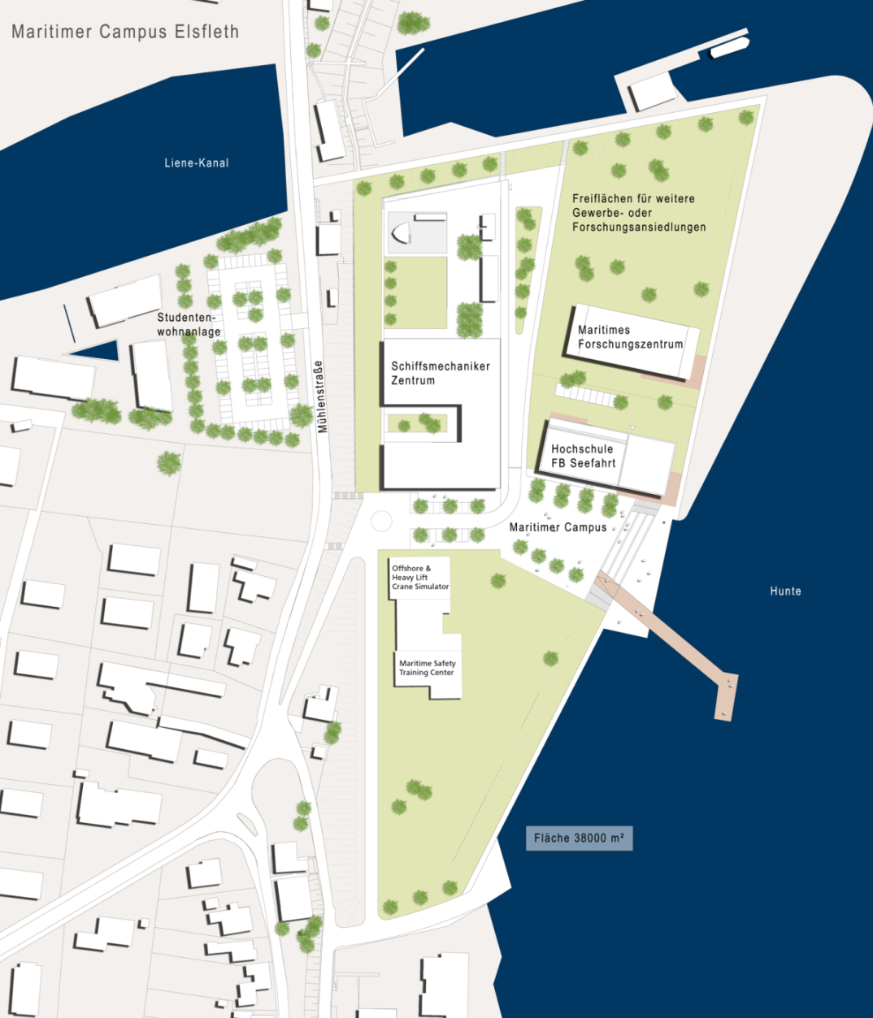
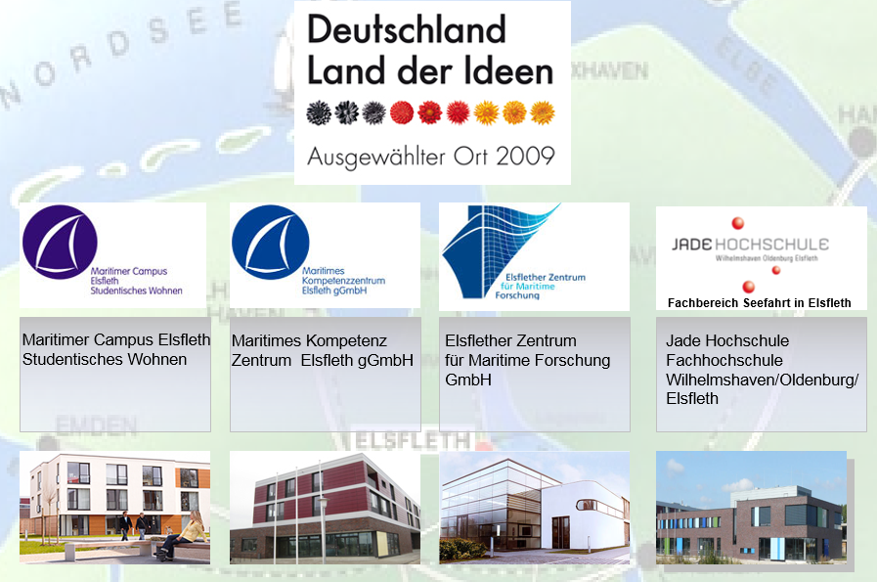
MARITIME CAMPUS IN ELSFLETH
Maritime Campus:
German national award as Place of Innovation 2009
Total area 30,000 sqm
University campus
Research centre
Vocational training
Notes:
As a public-private partnership between Jade Univ., city of Elsfleth, state of Lower Saxony and private companies, the Maritime Campus has created a unique competence center.

Slide 7
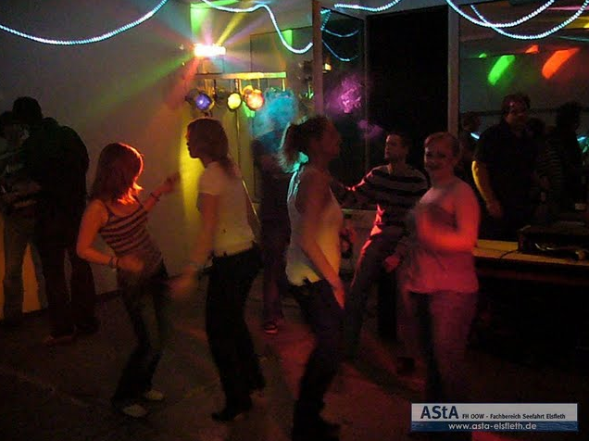
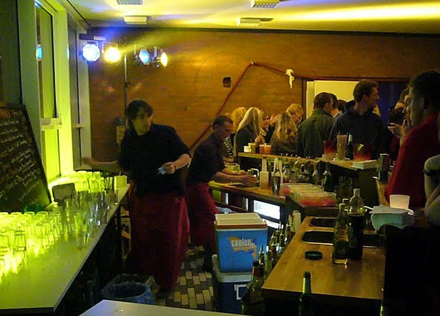
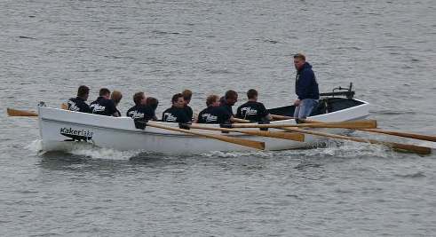
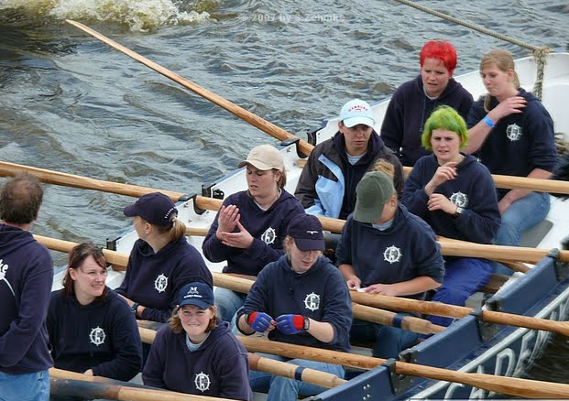

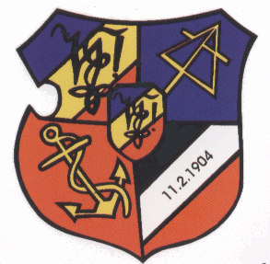

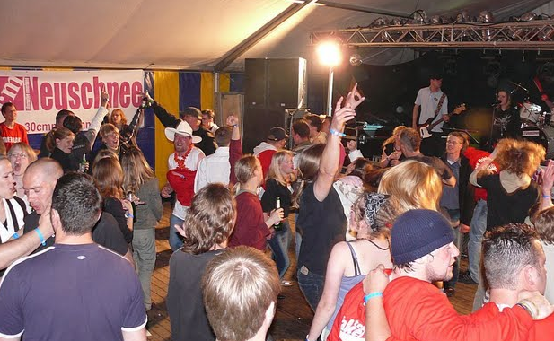


EVENTS IN ELSFLETH
First semester Party
Cinema evenings
„Kutter“ rowing
Maritime Contact Exchange
Nautical connections
Annual Maritime School Festival
Christmas Ball
Notes:
The events that are organized by the students association ASTA supported by our Dept.

Slide 8
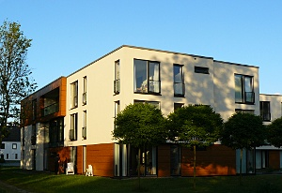
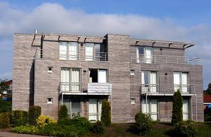
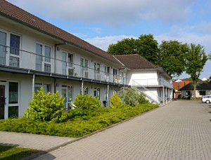
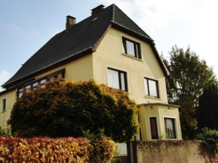
Student residence
„am Lienekanal“
LIVING IN ELSFLETH
The secretarial office can also
help students finding privately
rented rooms and flats
Student residence
„Peterstraße II“
Main building
Student residence
„Peterstraße I“
Beluga Villa

Slide 9
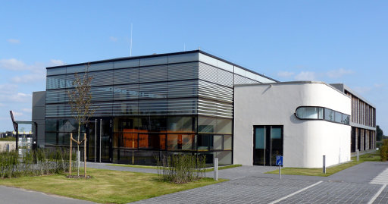
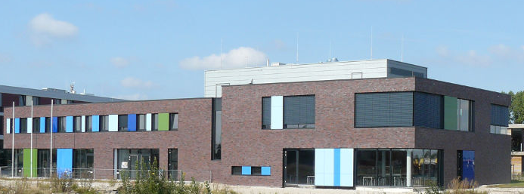
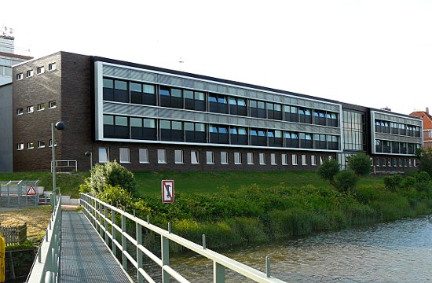
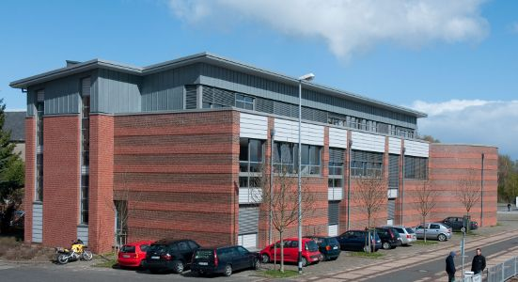
Maritime Research Center
STUDY CAMPUS ELSFLETH
Maritime Campus
Main building
Simulator building

Slide 10
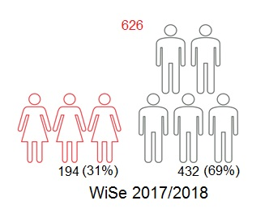
DEPARTMENT OF MARITIME AND LOGISTICS STUDIES
  626 Students:
  32 Employees
  17 Professors
  5 Study courses
Notes:
I want to emphasize once again the very active contact between lecturers and students, due to relative small nr. of students and the fact that the lectures are offered in small groups – average group size 20…30

Slide 11
COURSES OFFERED
Undergraduate
Nautical studies B.Sc.
Maritime Economics & Port Management B.Sc.
International Logistics Management B.Sc.
Postgraduate
Maritime Management M.Sc.
International Maritime Management (online)
Nautik
SHW
ILM
MM
IMM

Slide 12
BACHELOR - STUDY COURSES
8
7
6
5
4
3
2
1
Nautik SHW ILM

Slide 13
PRACTICAL SEMESTERS
8
7
Training as
deck cadet
Second work placement
Practical semester (work placement) within a foreign co.
6
5
Practical semester (work placement)
Practical semester on selected profile abroad
4
3
2
Training as
deck cadet
1
Nautik SHW ILM

Slide 14
SEMESTER(S) ABROAD
8
7
6
5
4
3
2
1
Nautik SHW ILM

Slide 15
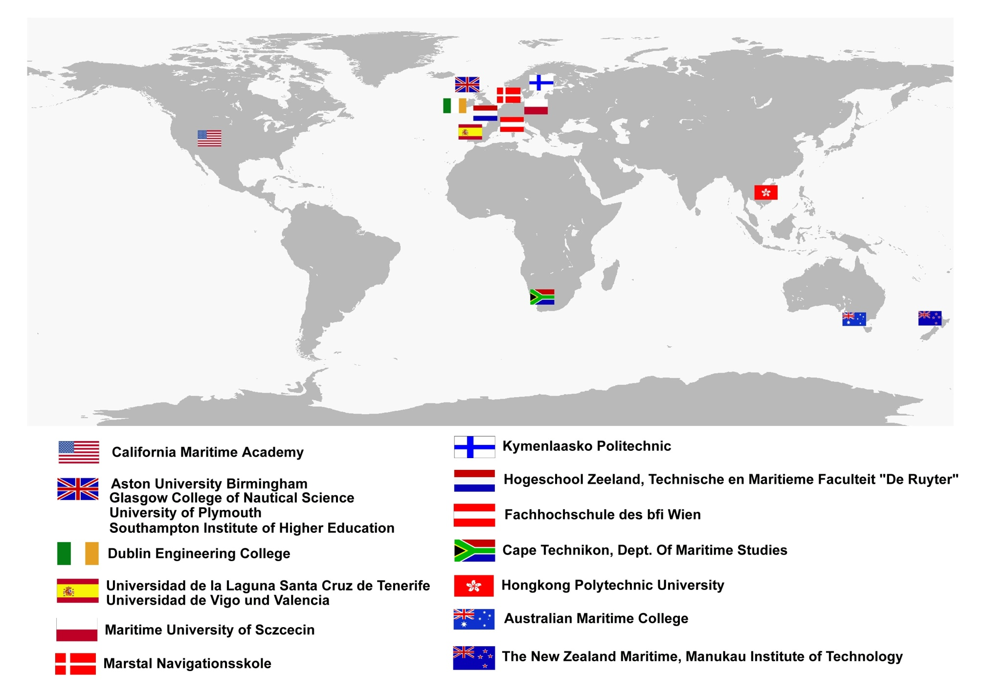
SOME OF OUR PARTNER UNIVERSITIES

Slide 16
1. NAUTICAL STUDIES (Nautik)
Qualification aims
Acquisition of the Nautical Certificate of a OOW (STCW)
Leadership skills and teamwork, especially in an intercultural context
Acquisition of basic scientific competence for entry into a master's program
Entry requirements
Technology- and management-oriented inclination profile
Medical fitness
Practical semesters at sea replaced by the training as Ship‘s mechanic or Navy Officer Assistant

Slide 17
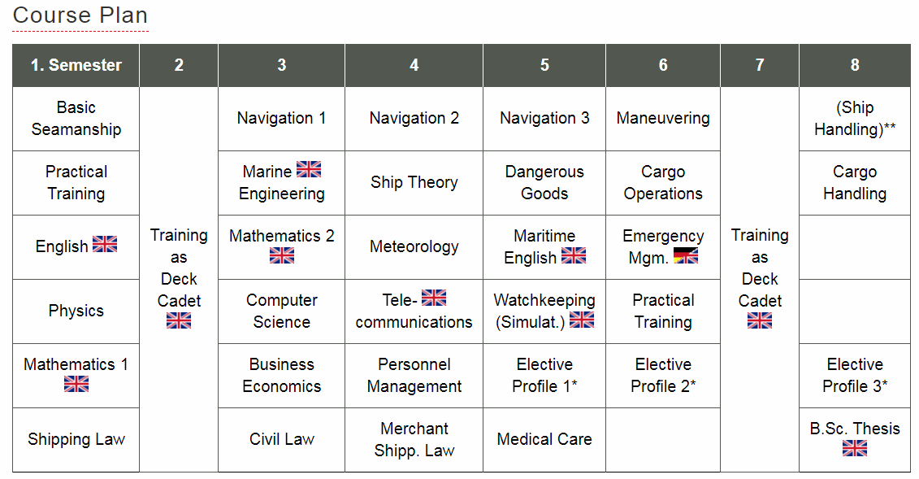
1. NAUTICAL STUDIES (Nautik)
* Students have the choice between the following elective profiles:
Profile - Maritime Technology: Physics in Maritime Applications, Maritime Technology (Lecture & Seminar)
Profile - Maritime Economics: Shipping Economics, Transport Management, Terminal Operations
Profile - Pilotage and VTS: Fairways and Pilotage, Communication and Intercultural Management, Vessel Traffic Services and Accident Analysis
Notes:
As you can see, nautical Science studies cover a wide range of subjects.
Basic (core) studies are taught in 3 semesters (1,2 and 3). The applied (main) subjects start with 4th semester and refer to specific topics necessary for working as a captain. Elective/optional courses are offered for all study courses: Tanker course, DP, 750 kW etc.

Slide 18
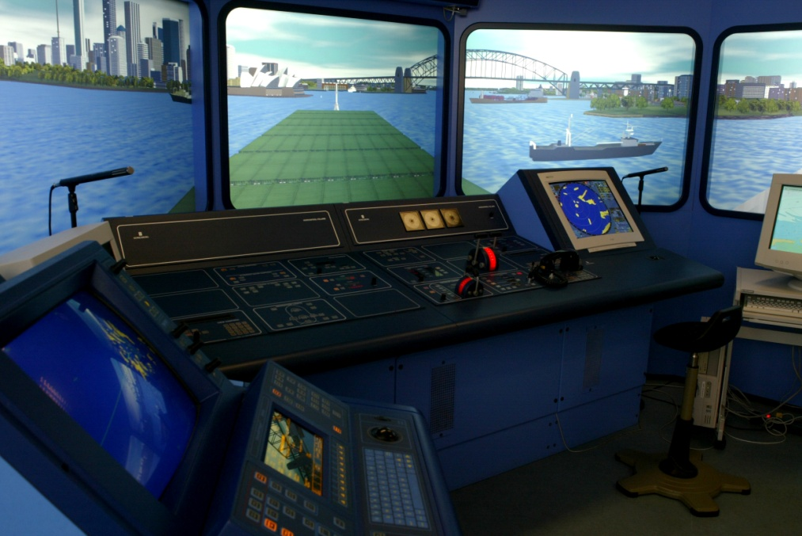
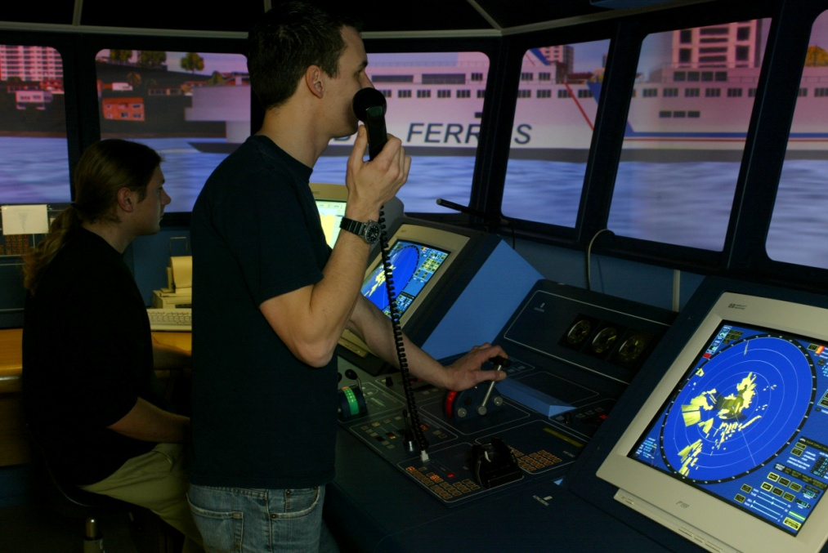
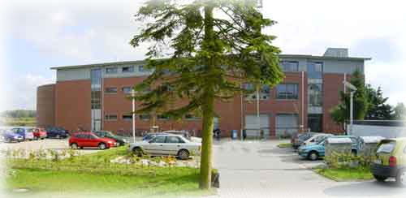
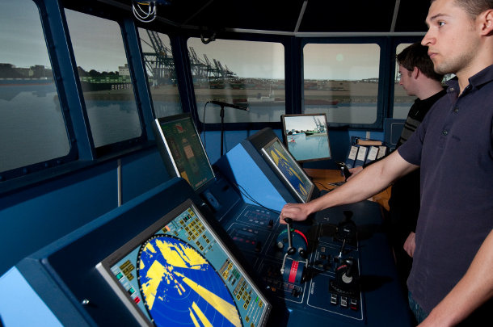
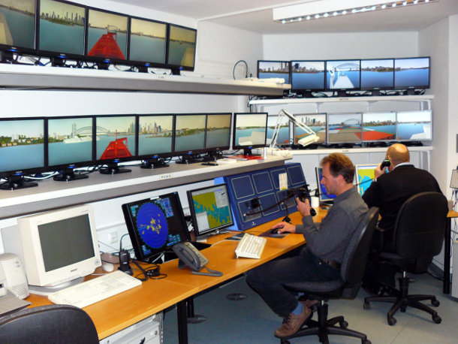
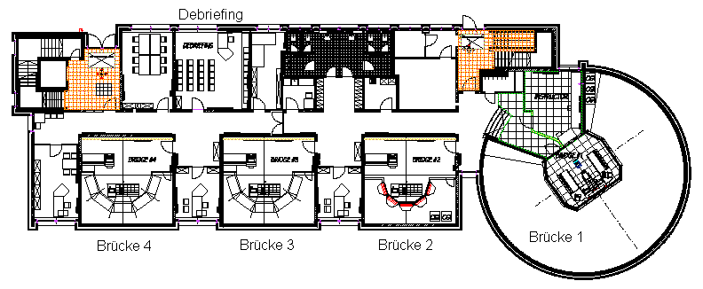
Elsfleth – Department of Maritime Studies
SIMULATOR BUILDING
Ground floor: Full mission ship bridge simulator
Notes:
Small groups of students (2-3) spend a total of 160 hrs in ship handling simulator during 3 semesters: 5, 6 and 8.
This is the largest proportion of training in simulators in comparison with other maritime univ. in Germany

Slide 19
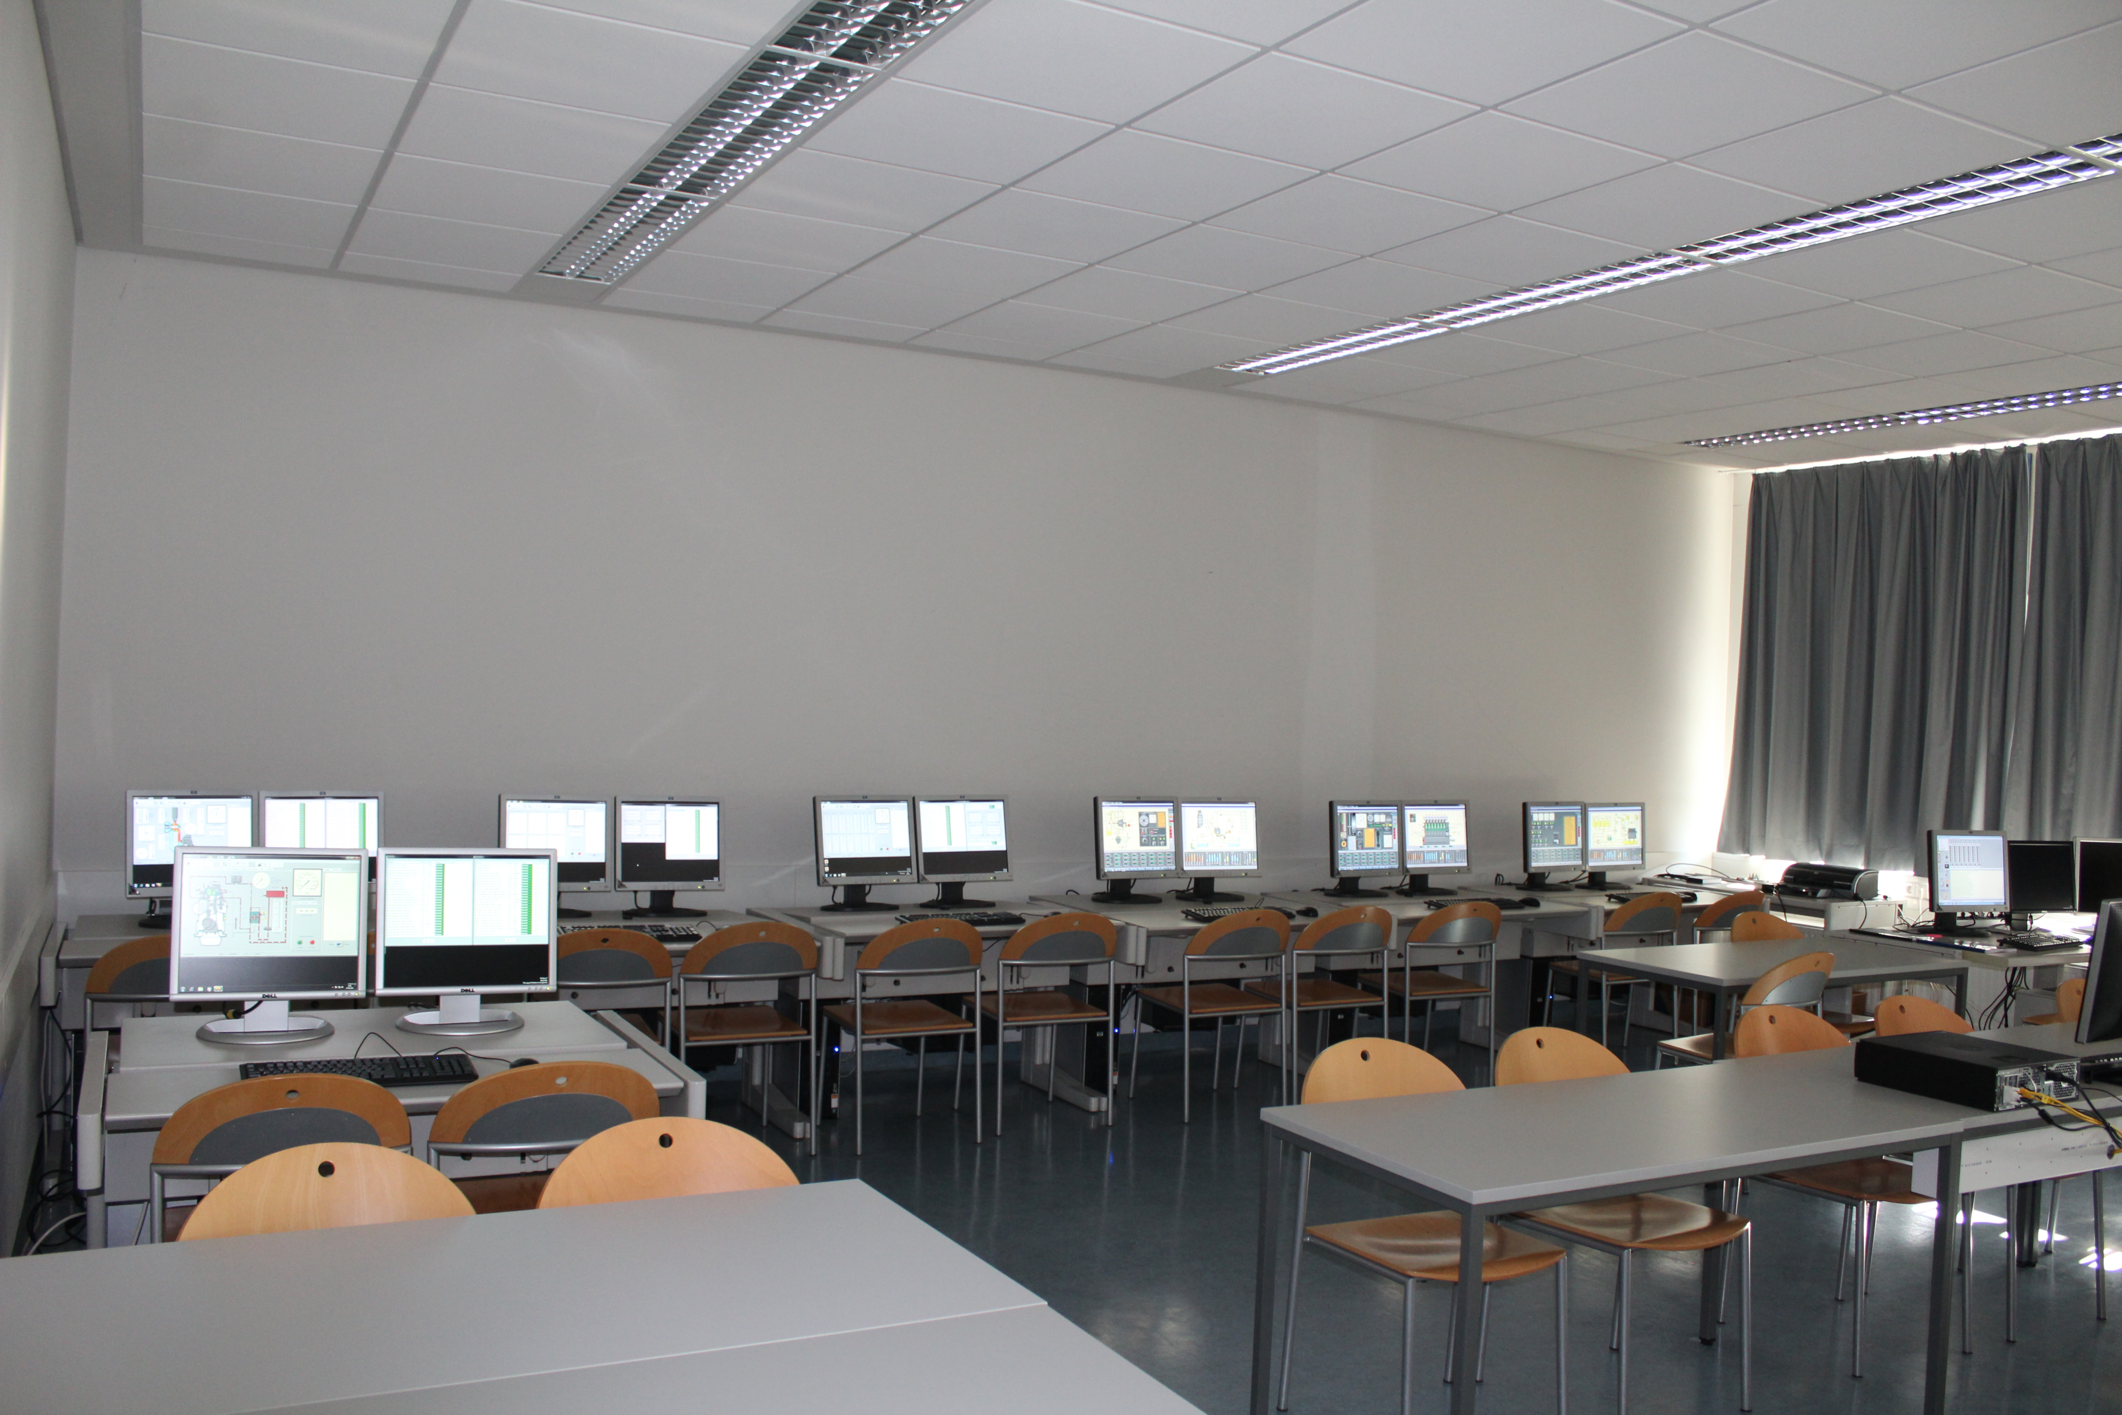
SIMULATOR BUILDING
First floor:
K- bridge simulator ECDIS
Liquid Cargo Handling simulator
Engine Room Simulator Unitest
Second floor:
Dynamic Positioning Simulator
PC-based Engine Room Simulator
PC-based Liquid Cargo Handling Sim.
Notes:
In addition, the students have the possibility to participate in elective courses like „DP for offshore operations“ in the DP simulator or „Tanker Course“ in the LCH sim. Or „TSM Ship Mechanics 750 kW“ in the ERSim.

Slide 20
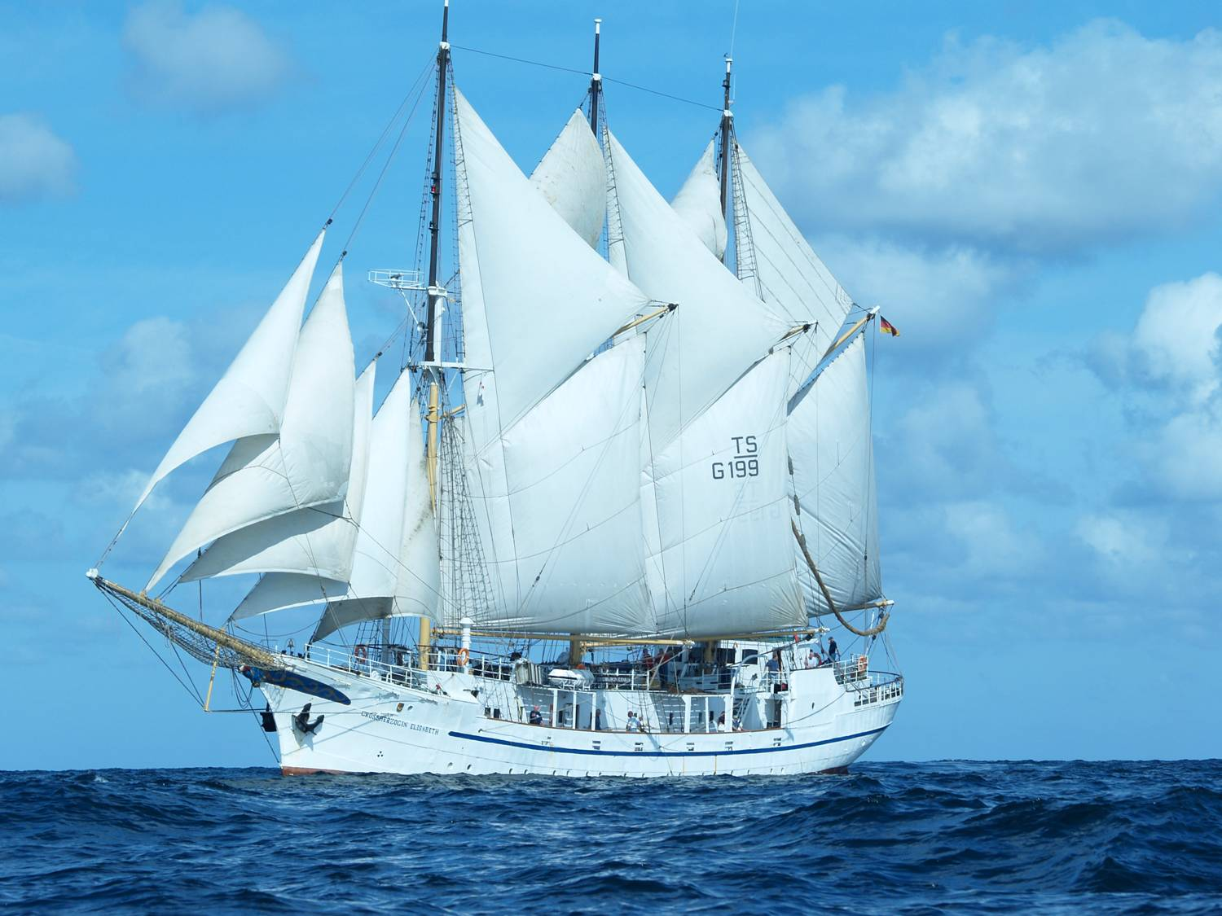
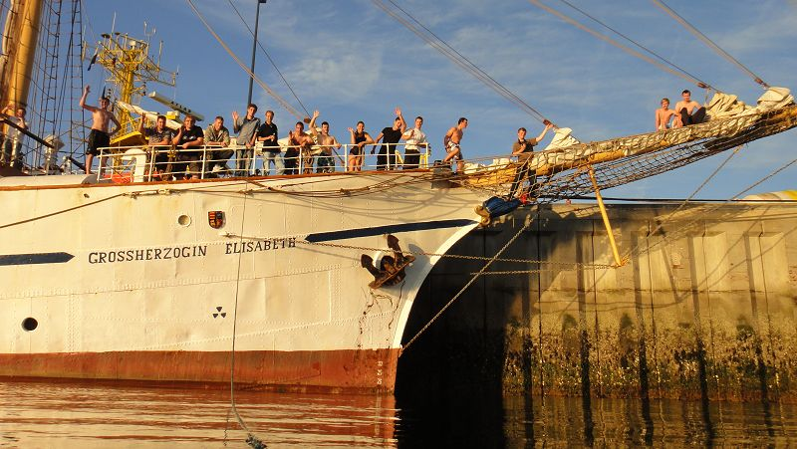
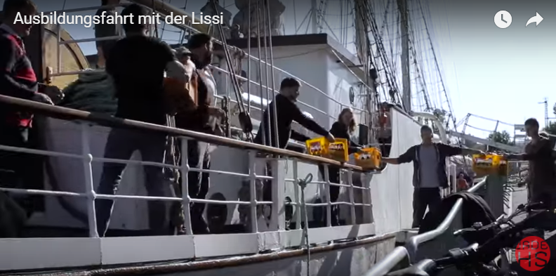
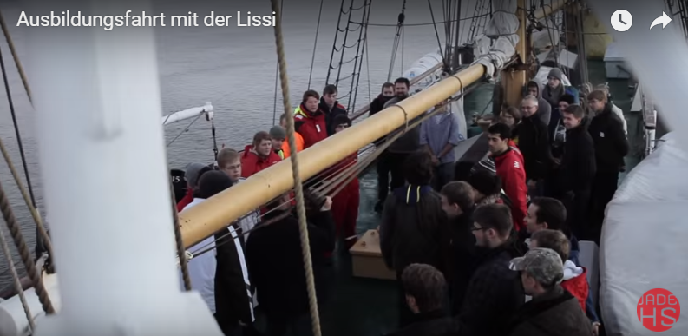
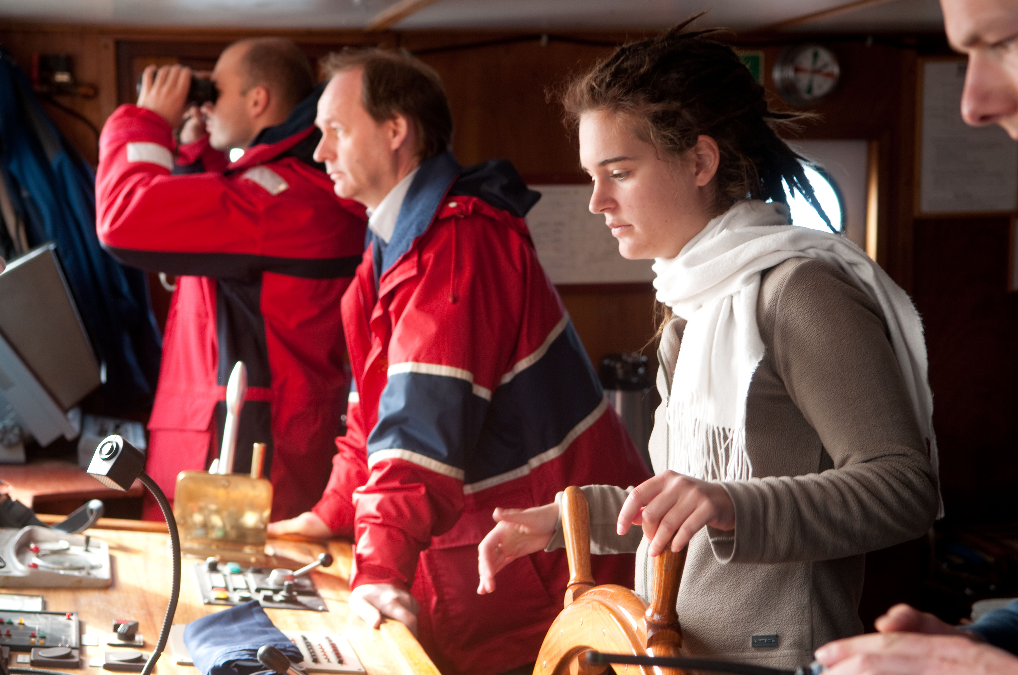
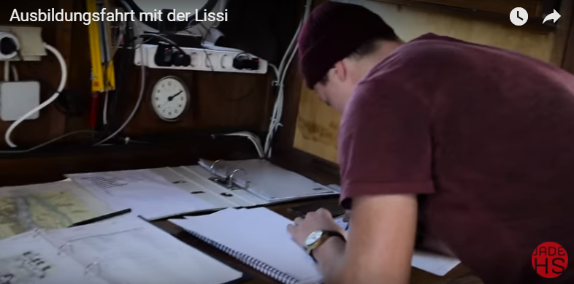
NAUTICAL STUDIES
Training voyage

Slide 21

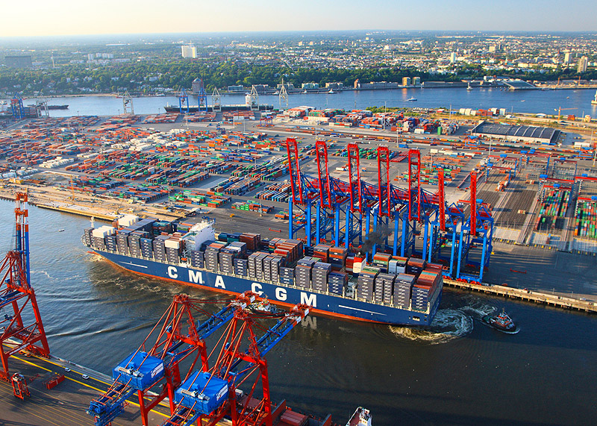
2. MARITIME ECONOMICS & PORT MANAGEMENT (SHW)
3. INTERNATIONAL LOGISTICS MANAGEMENT (ILM)
Qualification aims
Skills of an industrial engineer in the shipping industry/ (international) logistics
Problem-solving competence in the maritime-economic environment
Teamwork, especially in the international context
Acquisition of basic scientific competence for entry into the Master's program

Slide 22
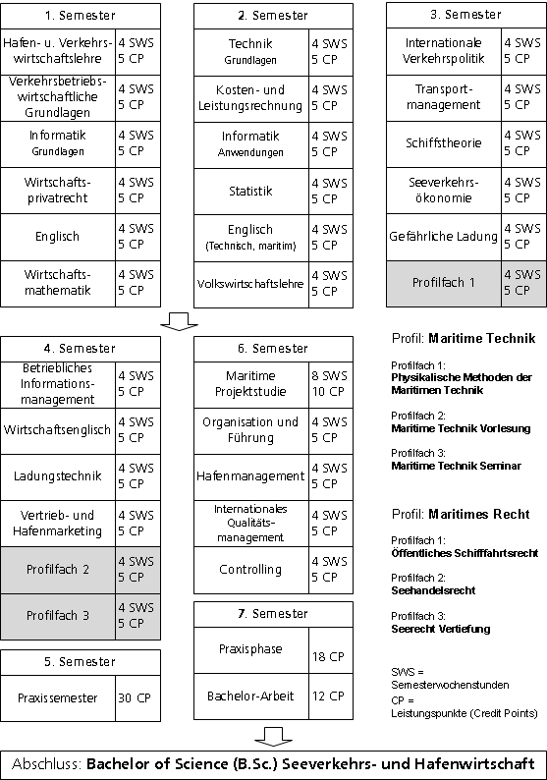
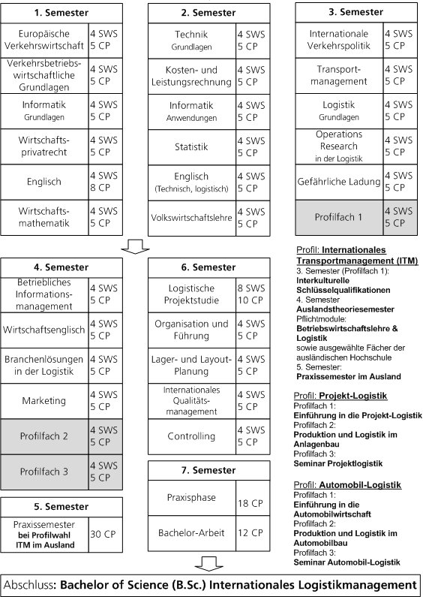
2. MARITIME ECONOMICS & PORT MANAGEMENT (SHW)
3. INTERNATIONAL LOGISTICS MANAGEMENT
Notes:
Sorry, the course plans are available at moment only in German language

Slide 23

4. MARITIME MANAGEMENT
Qualification aims
Broad, up-to-date knowledge of the maritime economy and international shipping law
Management competence in the context of maritime projects
Skills to evaluate and present results and key figures
Basic competencies in applied research

Slide 24
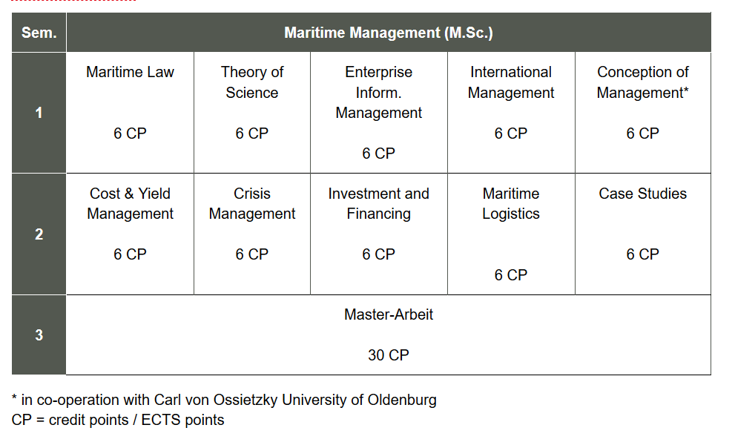
4. MARITIME MANAGEMENT
Course Plan
A “double-degree Master” M.Sc. / MBA is possible from WS 2011/12, with mutual recognition of modules with the AMC – Australian Maritime College/University of Tasmania
Notes:
90 Credit Points

Slide 25

5. INTERNATIONAL MARITIME MANAGEMENT
NEW
From WS 2017/18
Qualification aims
Broad, up-to-date knowledge of the maritime economy and international shipping law
Management competence in the context of maritime projects
Skills to evaluate and present results and key figures
Skill for scientific reflection in the profession of acquired experience
Skill to organize your own lifelong learning
Acquisition of an understanding of intercultural relations and international cooperation

Slide 26
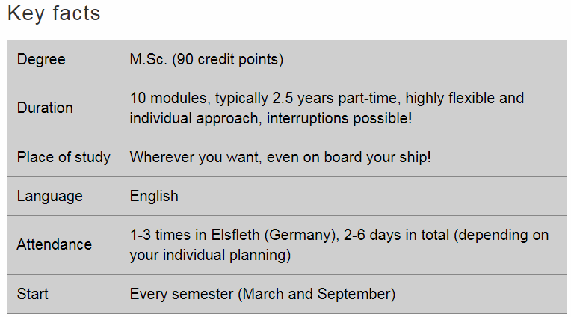
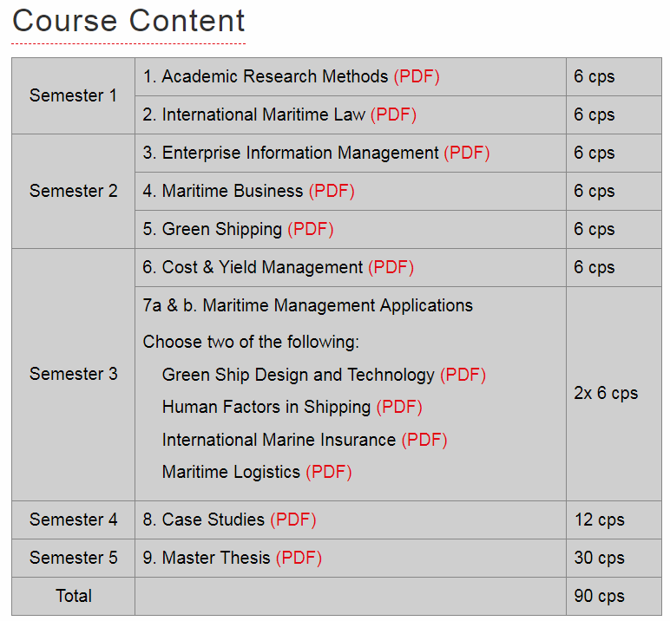
5. INTERNATIONAL MARITIME MANAGEMENT
Distance learning course
Dedicated to seafaring graduates or on-shore with maritime related occupation
High degree of flexibility of studying
Completely in English language

Slide 27
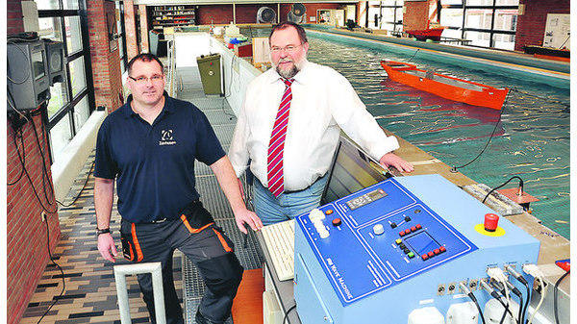
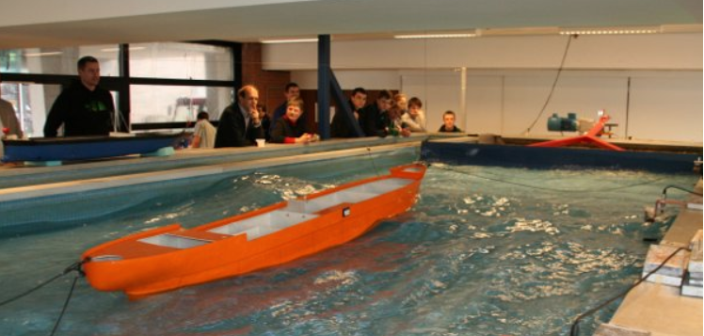

RESEARCH ACTIVITIES
Manoeuvring Tank
Has been renovated and modernised in 2010
Available for use in internal research within the university.
Current engine – create a laminar flow.
Two wind engines – mobile
Wave Machine - create wave patterns to be measured in natural conditions or simulated, in a form approximately scaled down to the model.
Bidirectional data transmission
Motion tracking
Computer-based master control
Radio-controlled wire-mounted camera

Slide 28


RESEARCH ACTIVITIES
Stricter requirements for environment and climate protection
Profitability pressure
Finiteness of fossil fuels
Green Shipping
Competence Centre

Slide 29






SOME OF OUR RESEARCH PROJECTS
IMaReS
Integrative manoeuvre realisation
system for automated steering of ships
PAMARCMIP
Polar Airborne Measurements and Arctic Regional Climate Model Simulation Project
greenMEPS
Mobile evaluation platform for ship assistance systems
EITAMS
Development of innovative
technologies for autonomous
maritime systems
Notes:
A comprehensive description of our research projects can be found in our website

Slide 30




RESEARCH FIELDS
Shipbuilding and maritime
system technology
(Ship dynamics,
Marine propulsion, metrology)
Maritime infrastructure
and logistics (port management, cargo technology, stowage planning)
Maritime ICT Technology (Applied Computer Science, Electronic Ship Portals, Electronic Information Systems)
Maritime education and vocational training
(according to IMO regulations,
Safety and Security)
Maritime Environmental Protection
Marine and Climate Research
(Emission Reduction, Green Shipping, Maritime Meteorology)

Slide 31

OUTLOOK
Development planning
Autonomous ships & digitalization
Strengthening of applied research
New study course offers
New study formats
Lifelong learning
Increase internationalization by expanding our network with further international universities
Enhance existing cooperation between JADE and your institutions !

Slide 32
Thank you for your attention !

