Slide 1
Department of Maritime and Logistics Studies
International Week 23rd – 27th April 2019
Laurentiu Chiotoroiu

Slide 2
JADE UNIVERSITY - HISTORY
1832 The Grand Duke Paul-Friedrich-August of Oldenburg founded the Nautical College in Elsfleth
1972 Integrated into the Univ. of Applied Sciences Oldenburg
1992 Start of a new „Maritime & Port Economics“ degree course
2000 Fusion of Applied Sciences Uni’s in the Northwest DE (OOW) (10,000 students in 5 locations)
Foundation of a new university with a new, catchy name:
“Jade University” with 3 locations
Notes:
So what kind of Campus are you entering today? The Dept. Of Maritime Studies is one of the oldest maritime school in Germany. It was founded …
Where the name comes from? Not as you probably thought, from the beautiful ornamental green rock „jade“

Slide 3
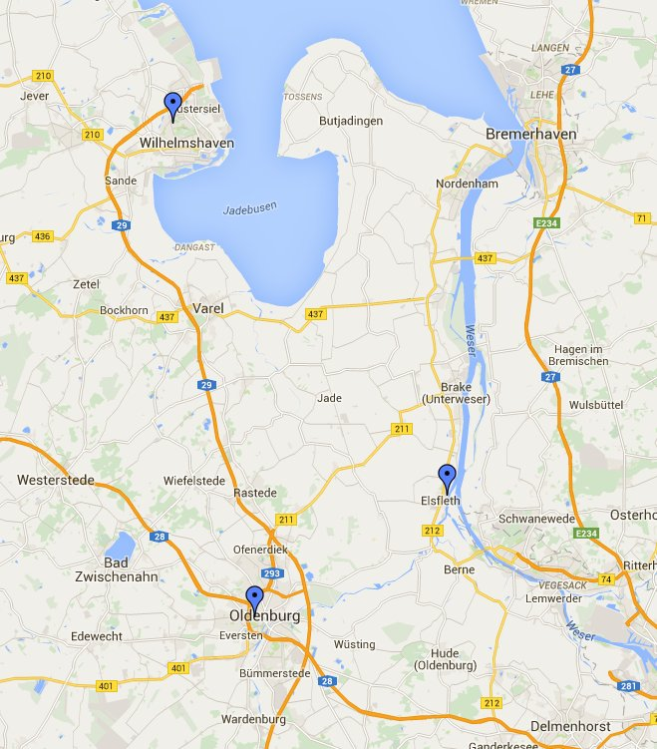
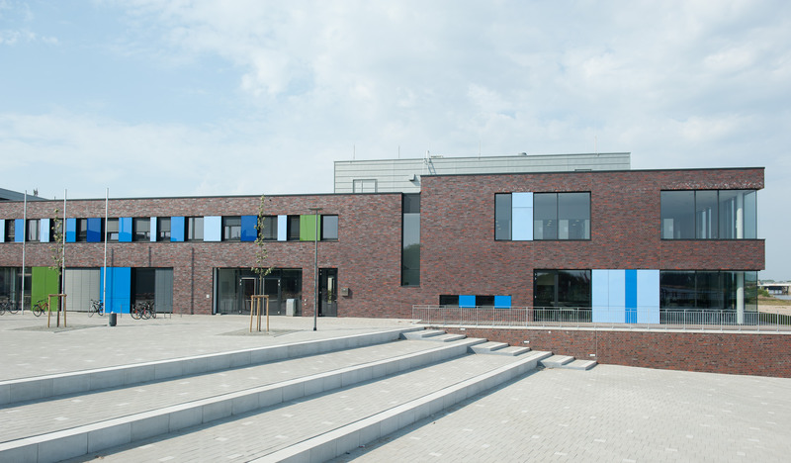
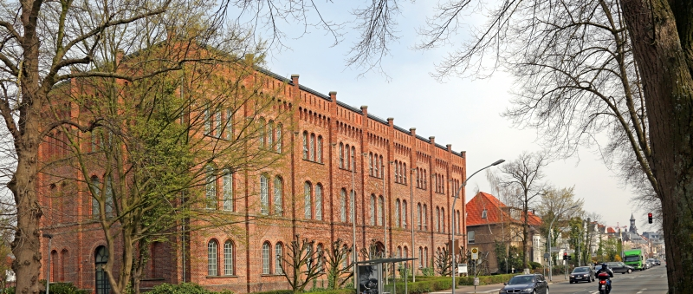
JADE UNIVERSITY – CAMPUSES LOCATION
Dept. of Business Administration and Management
Dept. Management Information and Technology
Dept. of Engineering Sciences
Dept. of Maritime and Logistics Studies
4,800 students
650 students
2,100 students
Dept. of Architecture
Dept. of Civil Engineering, Geo-information and Health Technology

Slide 4
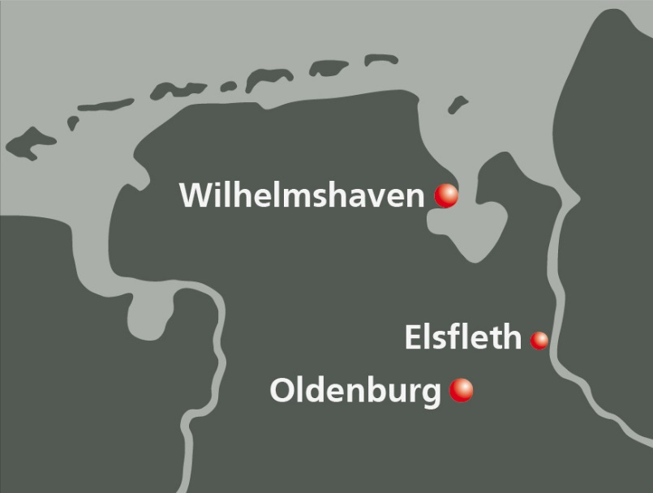
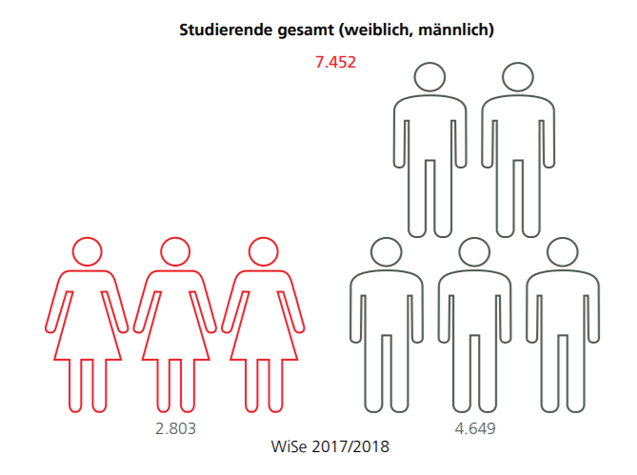
JADE UNIVERSITY - FACTS AND FIGURES
3 campuses
6 departments
7,452 total number of students
38 Bachelor-courses
12 Master-courses
500 number of employees
200 number of professors
90 partnerships/contacts in 30 countries
37%
63%

Slide 5
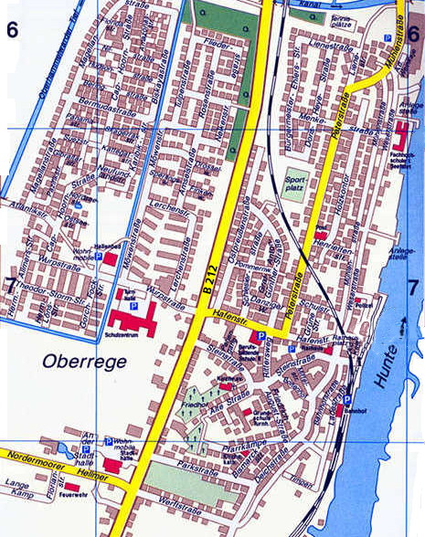
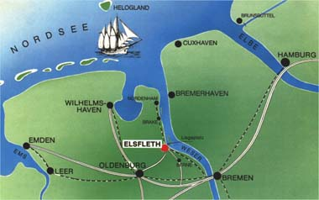
STUDY SITE ELSFLETH
Population of ca. 10,000
Very connected with seafaring and port economics
Location of 3 ship-owners companies
City with a maritime flair
Starting with 1832, here is the location of one of the biggest maritime university in Western Europe

Slide 6
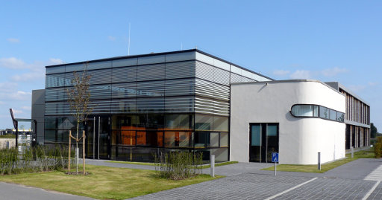
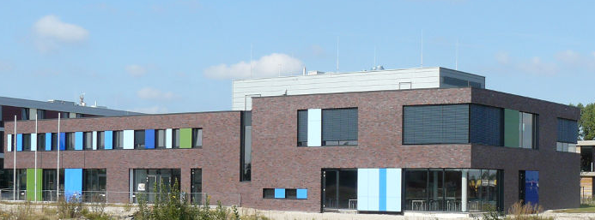
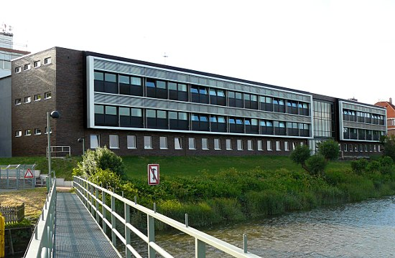
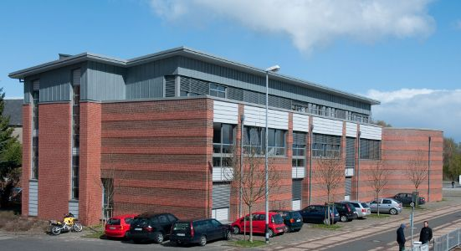
Maritime Research Center
STUDY CAMPUS ELSFLETH
Maritime Campus
Main building
Simulator building

Slide 7
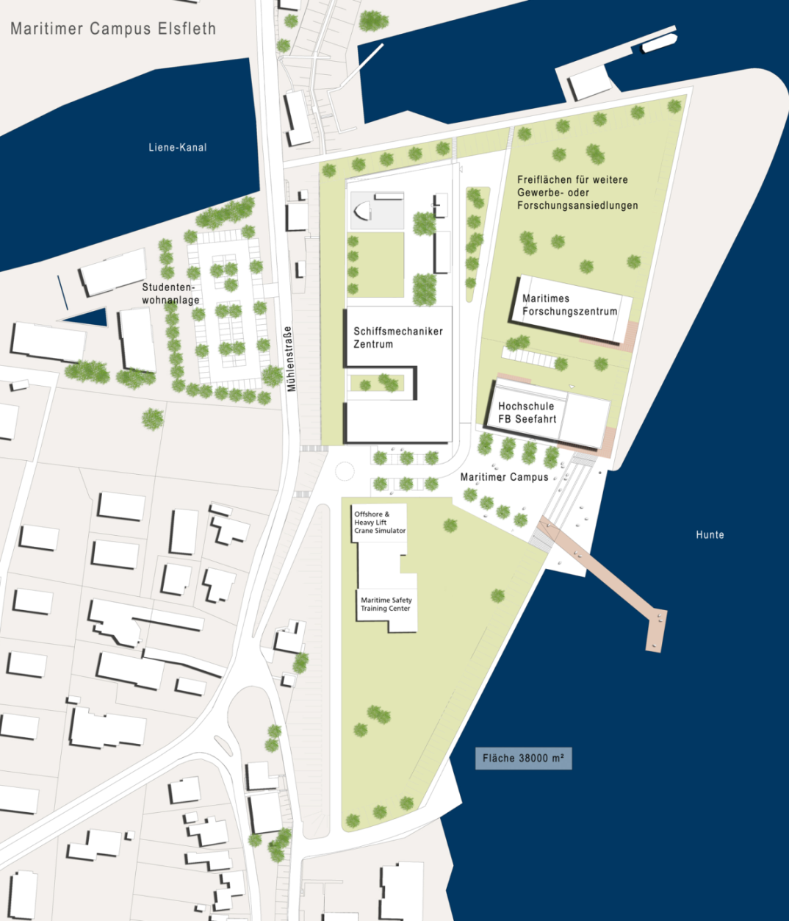
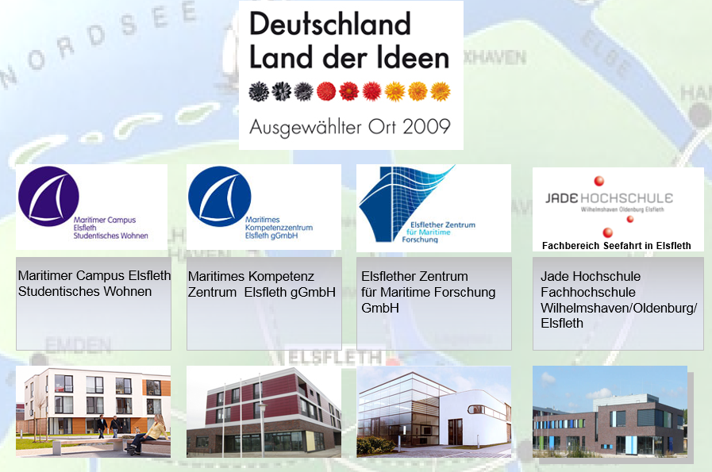
MARITIME CAMPUS IN ELSFLETH
Maritime Campus:
German national award as Place of Innovation 2009
Total area 30,000 sqm
University campus
Research centre
Vocational training
Notes:
As a public-private partnership between Jade Univ., city of Elsfleth, state of Lower Saxony and private companies, the Maritime Campus has created a unique competence center.

Slide 8
DEPARTMENT OF MARITIME AND LOGISTICS STUDIES
626 Students:
32 Employees
17 Professors
6 Study courses
Notes:
I want to emphasize once again the very active contact between lecturers and students, due to relative small nr. of students and the fact that the lectures are offered in small groups – average group size 20…30

Slide 9
COURSES OFFERED
Undergraduate
Ship and port operations dual
Nautical studies B.Sc. (Master Mariner)
Maritime Economics & Port Management B.Sc.
International Logistics Management B.Sc.
Postgraduate
Maritime Management M.Sc.
International Maritime Management (online)
NEW
WS 2018
SPO
NS
SHW
ILM
MM
IMM

Slide 10
BACHELOR - STUDY COURSES
8
7
Training as
deck cadet
6
5
4
3
2
Training as
deck cadet
1
SPO NS SHW ILM

Slide 11
SEMESTER(S) ABROAD
8
7
6
5
4
3
2
1
NS SHW ILM

Slide 12
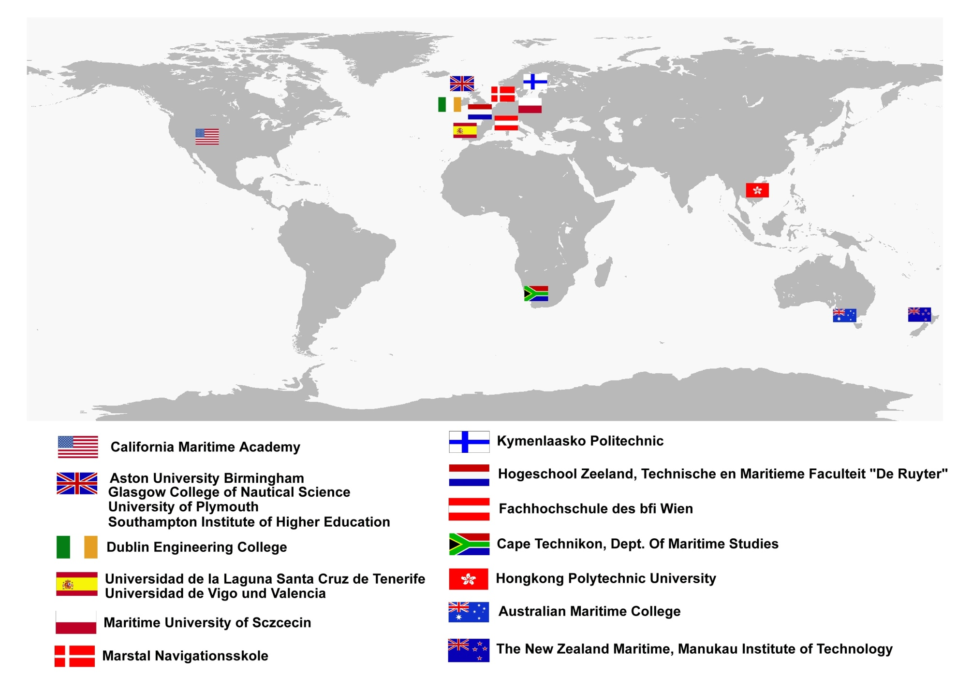
SOME OF OUR PARTNER UNIVERSITIES
Over 90 partner univ. at university level
Over 20 partner univ. at faculty level

Slide 13
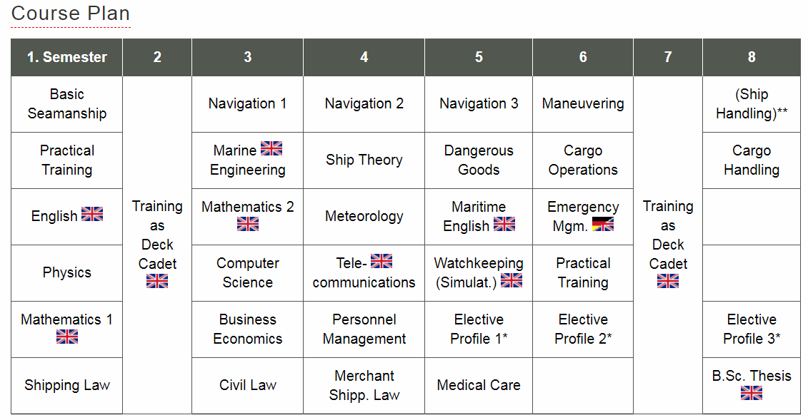
NAUTICAL STUDIES (Nautik)
* Students have the choice between the following elective profiles:
Profile - Maritime Technology: Physics in Maritime Applications, Maritime Technology (Lecture & Seminar)
Profile - Maritime Economics: Shipping Economics, Transport Management, Terminal Operations
Profile - Pilotage and VTS: Fairways and Pilotage, Communication and Intercultural Management, Vessel Traffic Services and Accident Analysis
Notes:
As you can see, nautical Science studies cover a wide range of subjects.
Basic (core) studies are taught in 3 semesters (1,2 and 3). The applied (main) subjects start with 4th semester and refer to specific topics necessary for working as a captain. Elective/optional courses are offered for all study courses: Tanker course, DP, 750 kW etc.

Slide 14
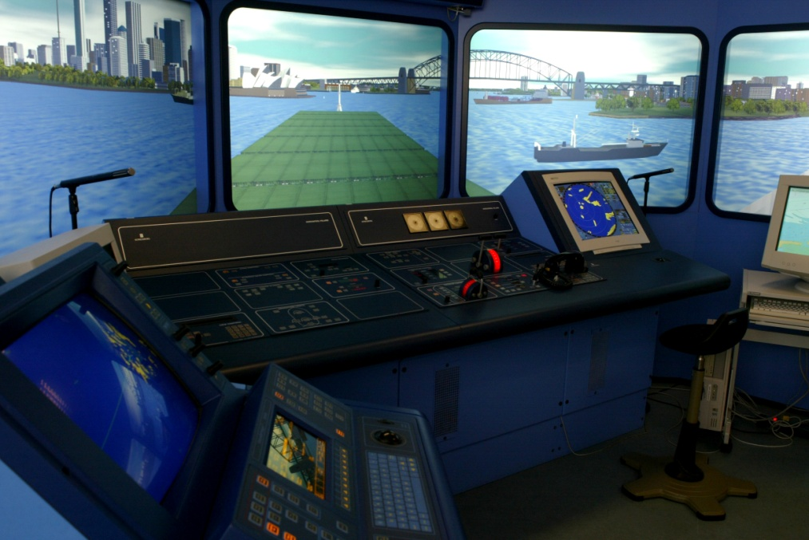
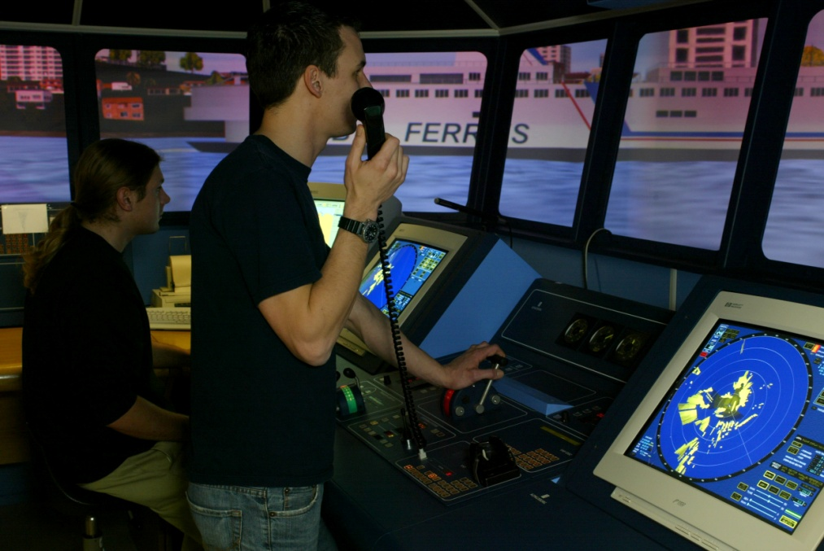
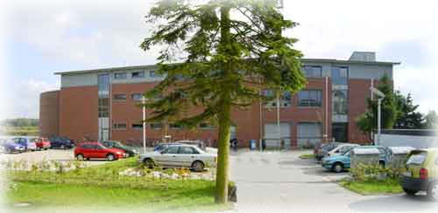
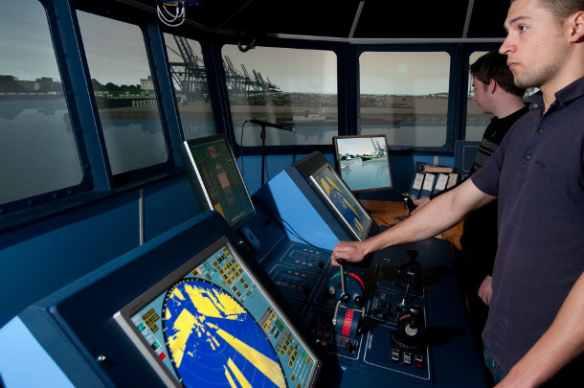
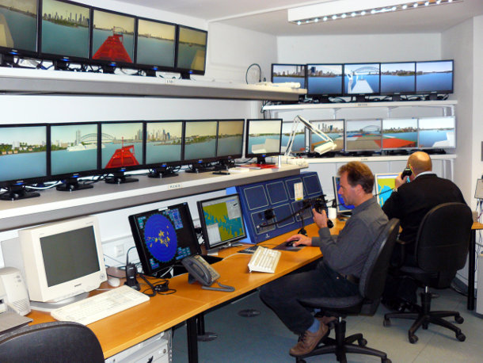
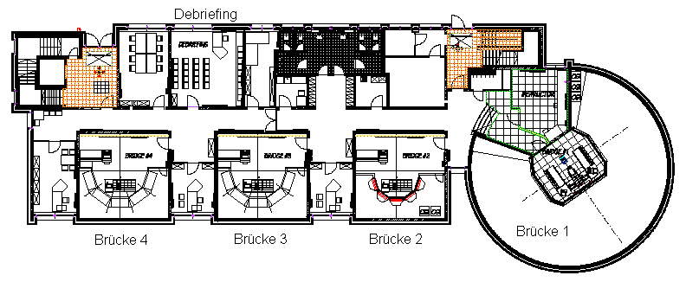
Elsfleth – Department of Maritime Studies
SIMULATOR BUILDING
Ground floor: Full mission ship bridge simulator K-SIM
Notes:
Small groups of students (2-3) spend a total of 160 hrs in ship handling simulator during 3 semesters: 5, 6 and 8.
This is the largest proportion of training in simulators in comparison with other maritime univ. in Germany

Slide 15
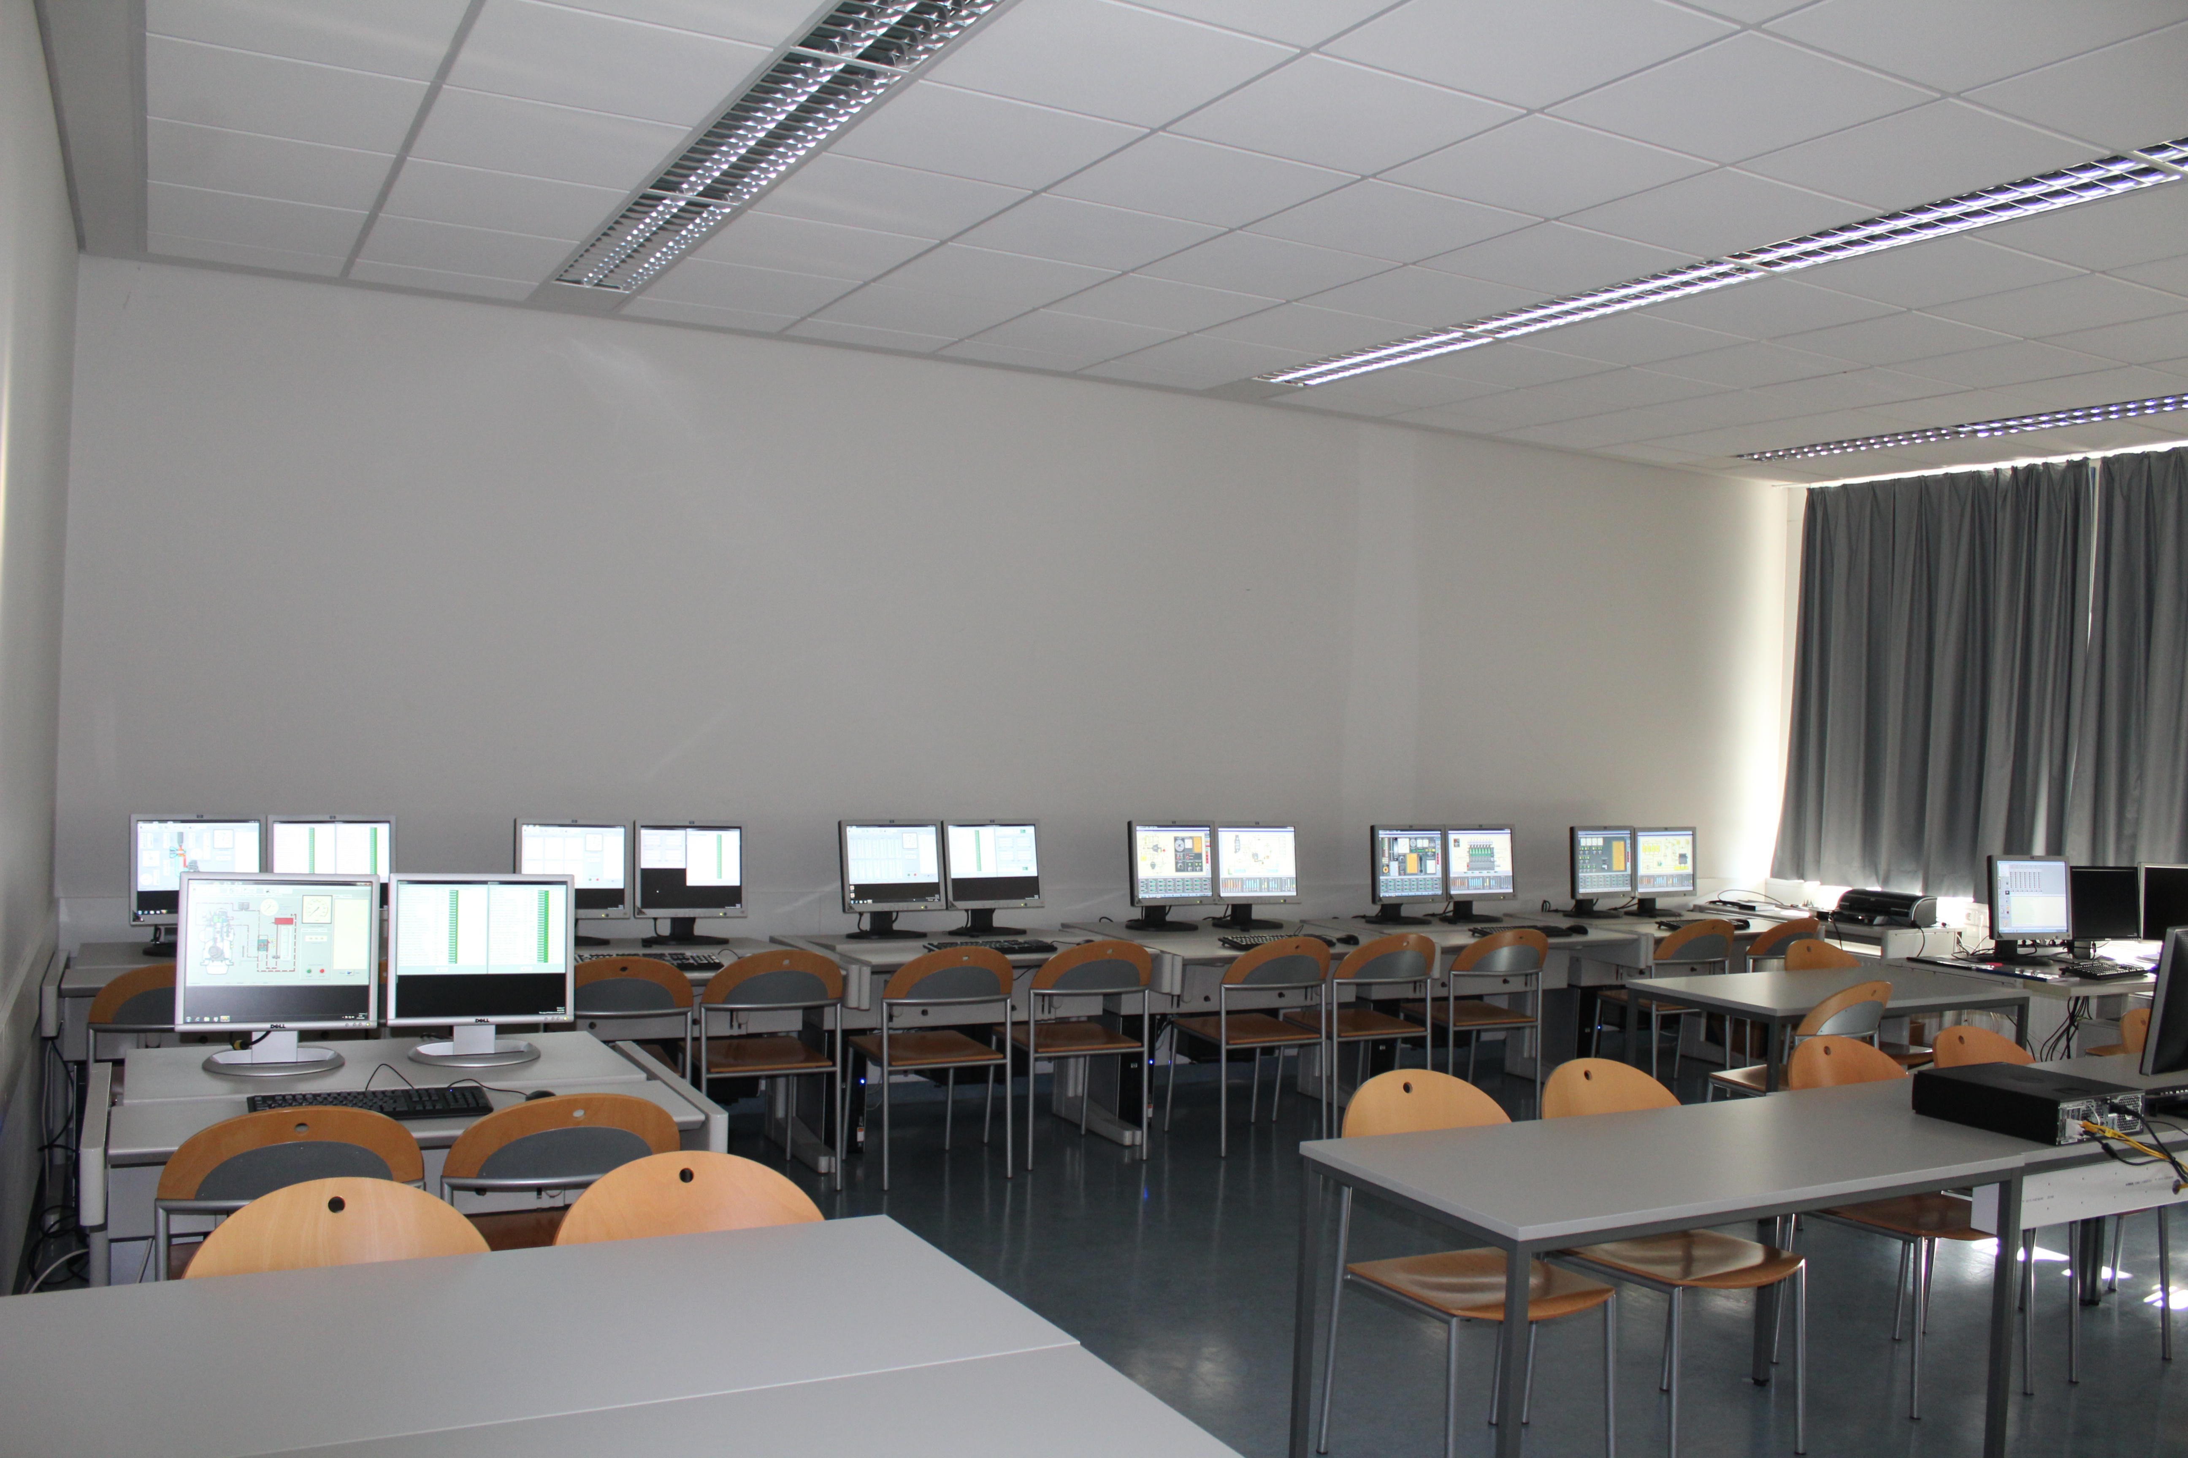
SIMULATOR BUILDING
First floor:
K- bridge simulator ECDIS
Liquid Cargo Handling simulator
Engine Room Simulator Unitest
Second floor:
Dynamic Positioning Simulator
PC-based Engine Room Simulator
PC-based Liquid Cargo Handling Sim.
Notes:
In addition, the students have the possibility to participate in elective courses like „DP for offshore operations“ in the DP simulator or „Tanker Course“ in the LCH sim. Or „TSM Ship Mechanics 750 kW“ in the ERSim.

Slide 16
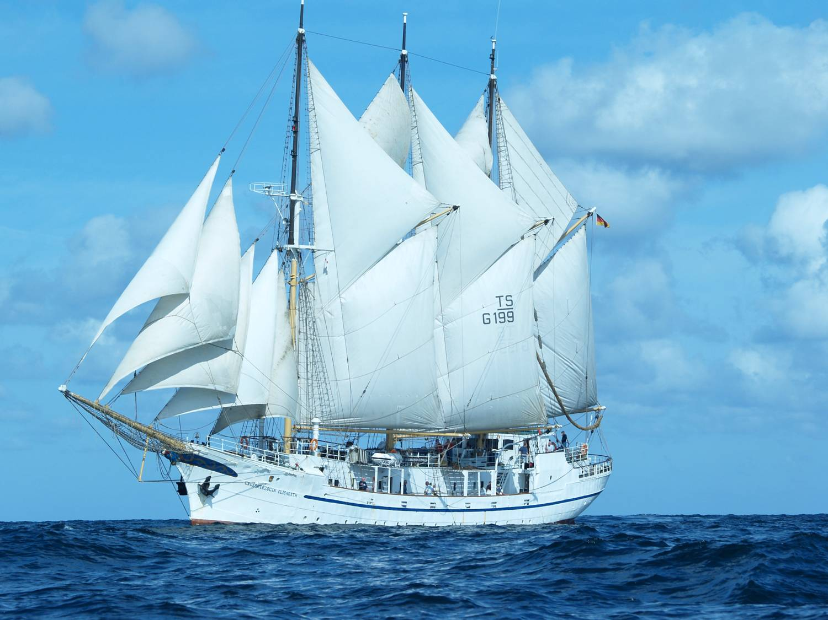
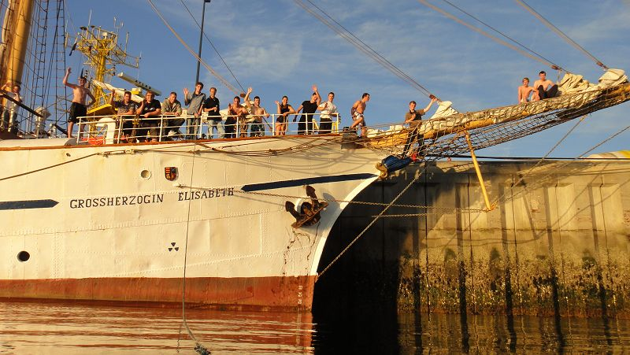
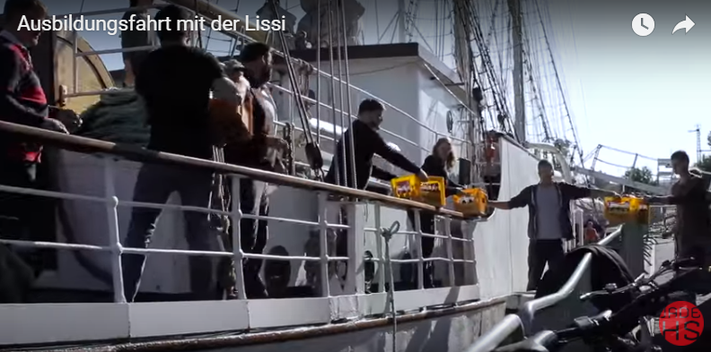
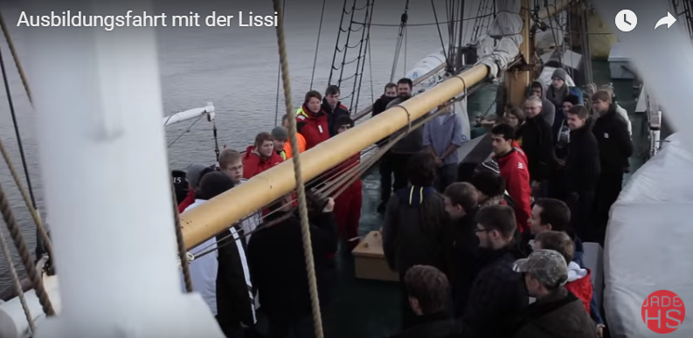
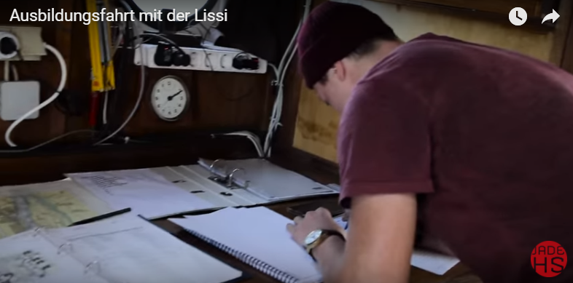
NAUTICAL STUDIES
Training voyage

Slide 17
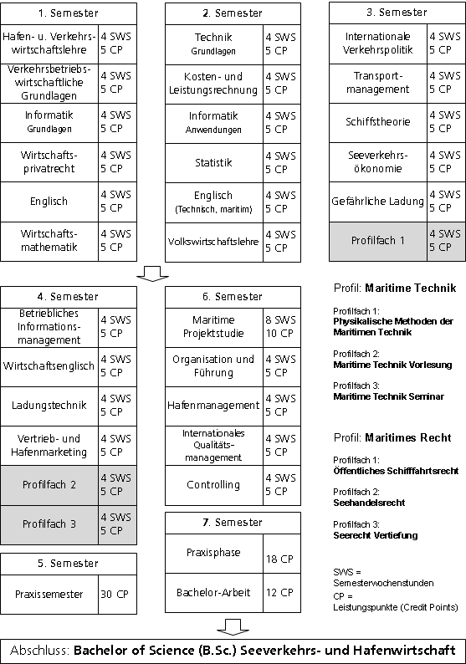
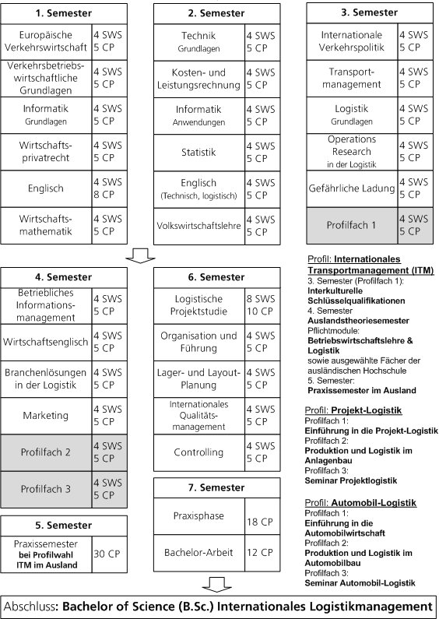
MARITIME ECONOMICS & PORT MANAGEMENT (SHW)
INTERNATIONAL LOGISTICS MANAGEMENT
Notes:
Sorry, the course plans are available at moment only in German language

Slide 18
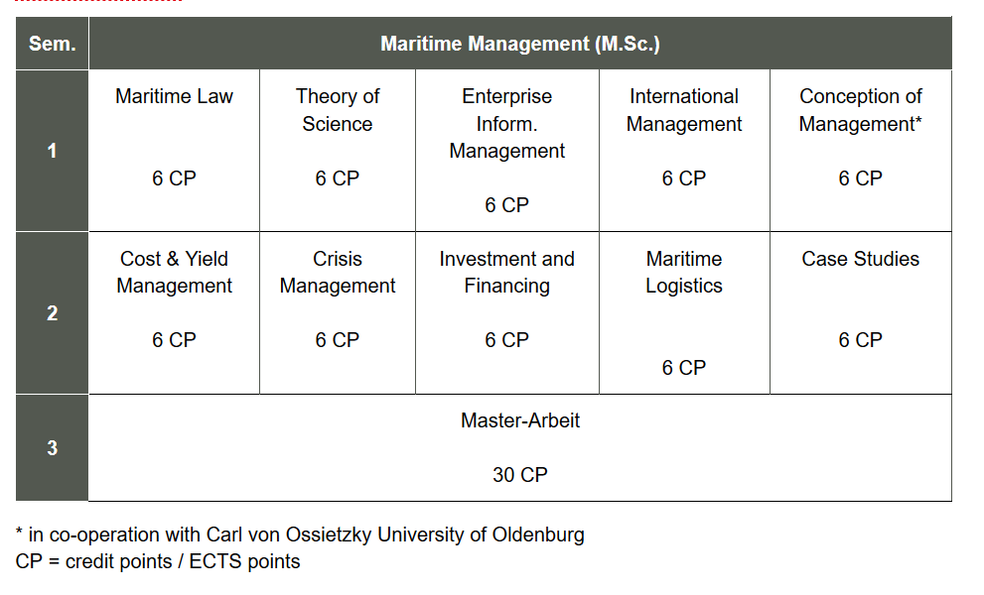
MARITIME MANAGEMENT
Course Plan
Notes:
90 Credit Points

Slide 19
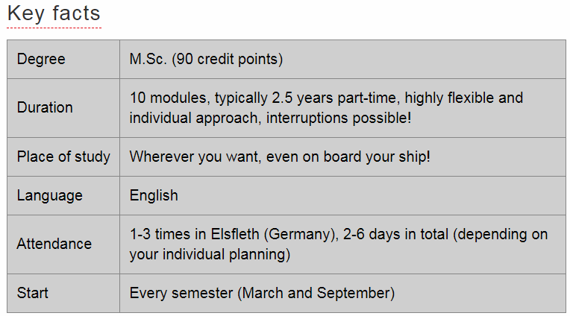
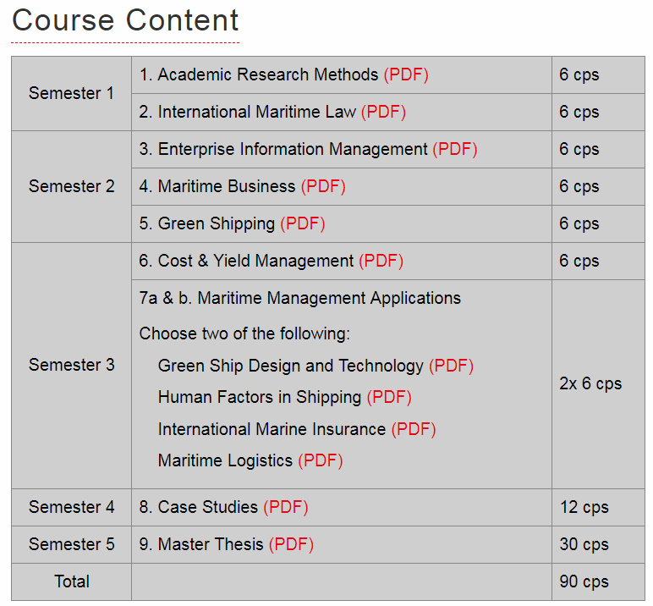
INTERNATIONAL MARITIME MANAGEMENT
Distance learning course
Dedicated to seafaring graduates or on-shore with maritime related occupation
High degree of flexibility of studying
Completely in English language
NEW
WS 2017/18

Slide 20
PILOT PROJECT: SUMMER SCHOOL 2019
„International Shipping and Maritime Logistics“
Study level: undergraduate (BSc. level)
Date: 01.09 – 20.09.2019
Duration: 3 weeks
Course language: English
Size of summer school: 15 – 20 participants
Target audience: Students from maritime & logistics studies

Slide 21
COURSE STRUCTURE
Area 1:
Maritime Operations & Technologies
Area 2:
Maritime Business & Logistics
Area 3:
IT Applications & Business Basics
Modules:
Modules:
Modules:
Concept design of a project ship
Maritime Communication Technologies
Voyage planning
Port state control
…
Maritime logistics & Marketing strategies
Port management
Supply chain management
Project management
…
Transport chain simulation
Big data analysis
VBA programming with Excel
Statistics with Excel
Intercultural training
…
Invited foreign partners may suggest further modules!

Slide 22
COURSE STRUCTURE
Area 1:
Maritime Operations & Technologies
Area 2:
Maritime Business & Logistics
Area 3:
IT Applications & Business Basics
Each student selects
2 modules
from area 1
or
2 modules
from area 2
and
1 module
from area 3

Slide 23
ACTIVITIES & COSTS FOR THE SUMMER SCHOOL 2019
Regular in-class lectures and guest lectures (8 contact hours + 2 self study per day)
Out-of-class field trips on Fridays to partner companies (Meyer Shipyard, Mercedes-Benz, Beck’s Brewery, Container Terminal etc.)
Social and cultural programme: city walking tour in Oldenburg, Bremen, Bremerhaven, Food festival & Grill championship etc.
Course fee is 500 EUR
Accommodation for students is free of charge
Meals in the hostel cost about 11 EUR/day
Individual payment for the field trips & social programme.
Possible financial support from DAAD and/or Erasmus + programme !

Slide 24
Thank you for your attention !

