Slide 1
WELCOME TO I.M.M. ELECTIVE MODULE:
IMM 0702
GREEN SHIP DESIGN AND TECHNOLOGY
WINTER TERM 2018/19
Elsfleth, 14.09.2018

Slide 2
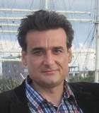
SUPERVISOR:
GREEN SHIP DESIGN AND TECHNOLOGY
Prof. Dr.-Ing. Laurentiu Chiotoroiu
Since 2007: Professor at Jade Univ. of Applied Sciences
Dept. Of Maritime and Logistics Studies
Marine engineering
Elective course for „750 kW license as ship machinist“
Mathematics
Ship theory

Slide 3
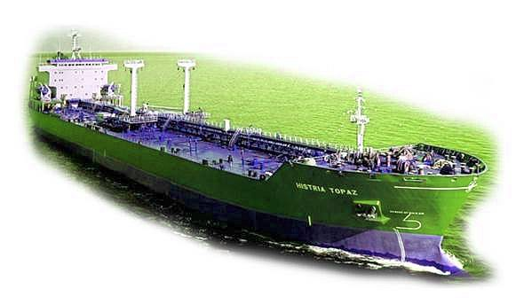
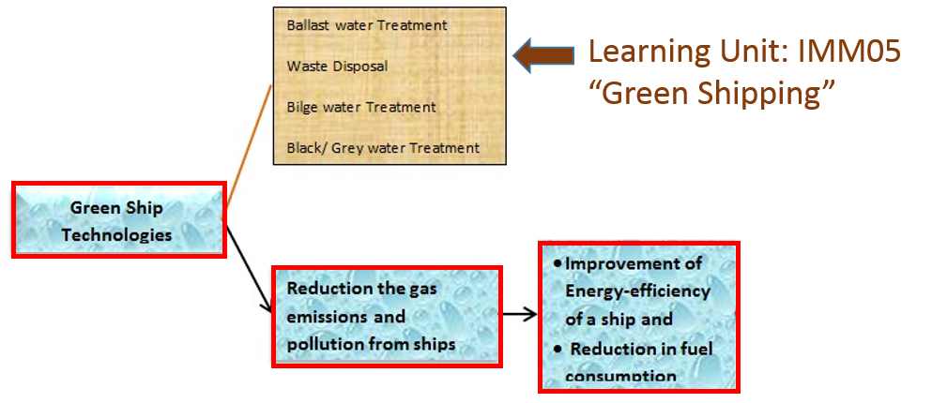
MAIN GOAL:
GREEN SHIP DESIGN AND TECHNOLOGY
To answer the question: How…
To design a newbuild
To retrofit an existing ship
using available technical solutions
to get an
„eco-friendly ship“
Solution: create an energy-efficient ship with emphasis on „fuel efficiency“

Slide 4
GREEN SHIP DESIGN AND TECHNOLOGY
MODULE STRUCTURE:
1. THEORETICAL PART: GREEN SHIP DESIGN & TECHNOLOGY
2. PRACTICAL APPLICATION PART: CONCEPT DESIGN OF A PROJECT SHIP
Exam is a:
Self-assessment test after each chapter
Tests made up of 25 questions. Time limit of 1 hour
A score of 71 % is needed to pass the test
The number of attempts is unlimited
Individual assignment in form of a Home project
Exam is:
A home project report uploaded in Moodle LMS
Notes:
A first part containing the unit‘s basic thoretical principles and
A second part for the practical application of the conceps introduced
Each test is made up of 30 questions that are randomly chosen from a test bank of hundreds of questions
The questions could be single- or multiple-choice questions, numeric questions, matching questions, close questions or image questions.
The test has a time limit of one hour and is designed to provide enough time for all students to complete the exam

Slide 5
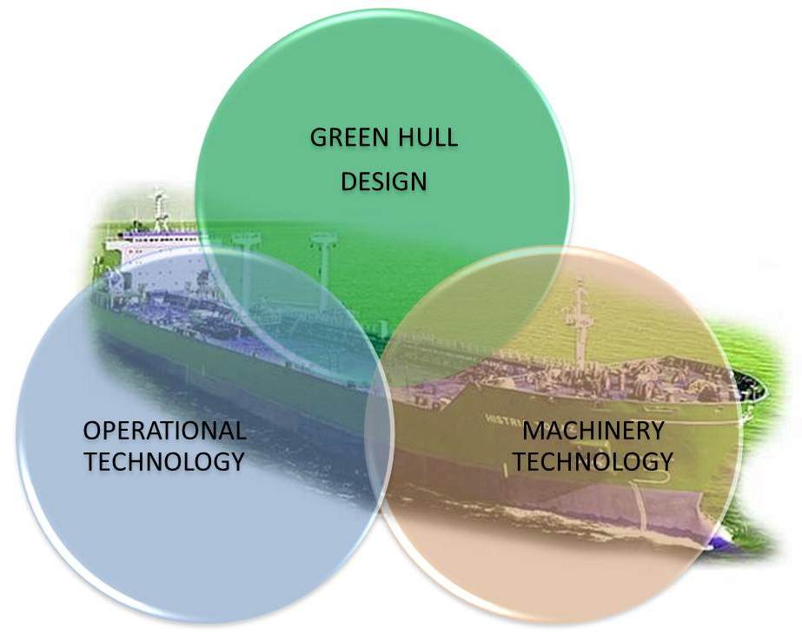
GREEN SHIP DESIGN AND TECHNOLOGY
MODULE STRUCTURE:
PART 1. Basic theoretical principles: GREEN SHIP DESIGN & TECHNOLOGY
Chapter 1. GREEN SHIP DESIGN
Self-assessment test 1
Chapter.2. MACHINERY TECHNOLOGIES
Self-assessment test 2
Chapter 3. OPERATIONAL TECHNOLOGIES
Self-assessment test 3

Slide 6
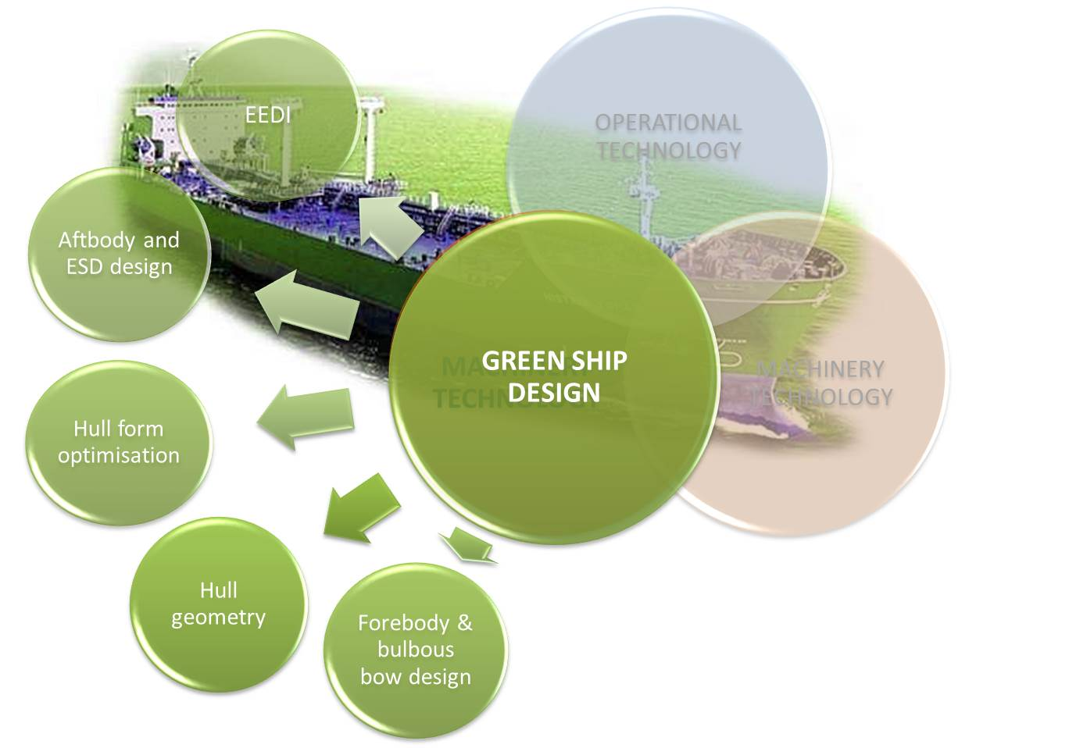
GREEN SHIP DESIGN AND TECHNOLOGY
MODULE STRUCTURE:
CHAPTER 1. GREEN SHIP DESIGN
Main dimensions, ratios and form coefficients
Lines drawing and hull form optimisation
Forebody and bulbous bow design
Aftbody and energy-saving devices
Influence of EEDI on green ship design

Slide 7
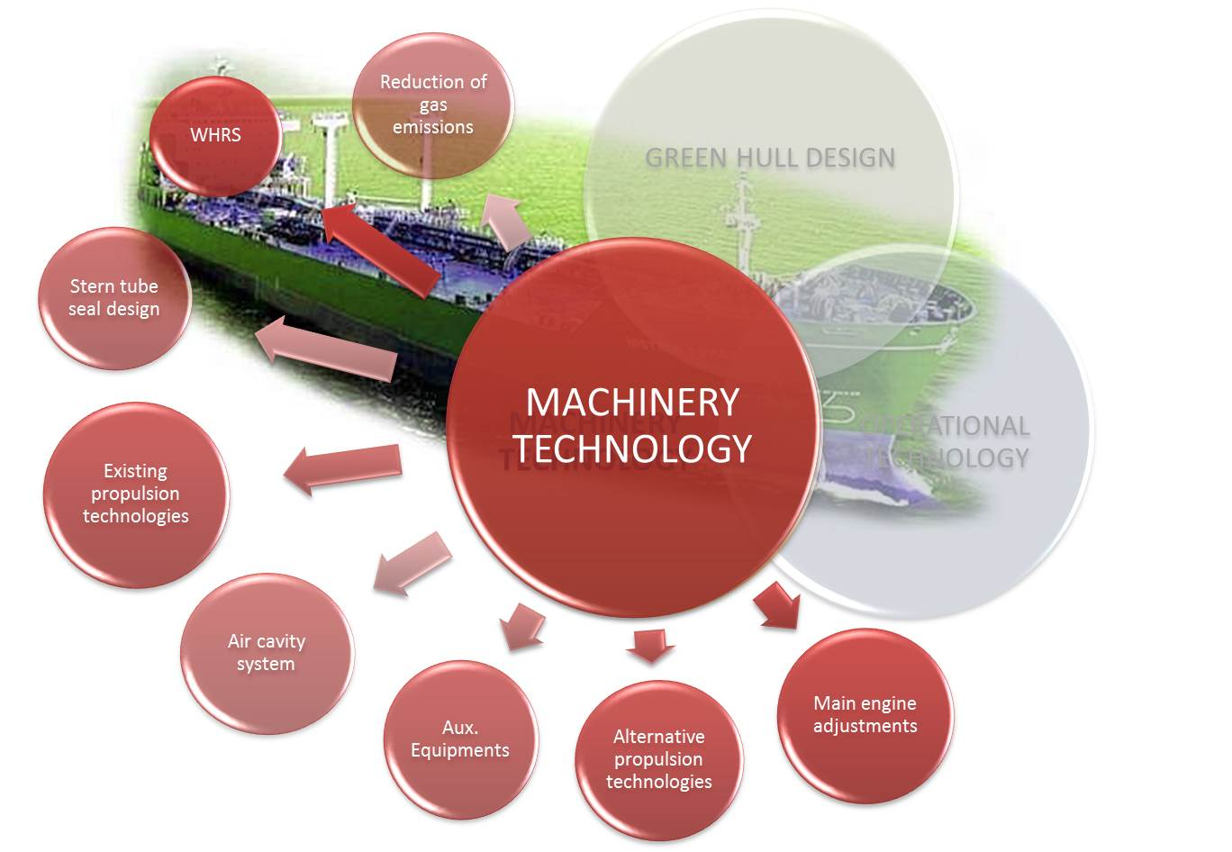
GREEN SHIP DESIGN AND TECHNOLOGY
MODULE STRUCTURE:
CHAPTER 2. MACHINERY TECHNOLOGIES
Existent prime movers and propulsion technologies
Alternative propulsion technologies
Main engine adjustments
Waste Heat Recovery Systems
Auxiliary‘s equipments
Stern tube seal design
Technologies to reduce gas emissions
Hull air lubrication systems

Slide 8
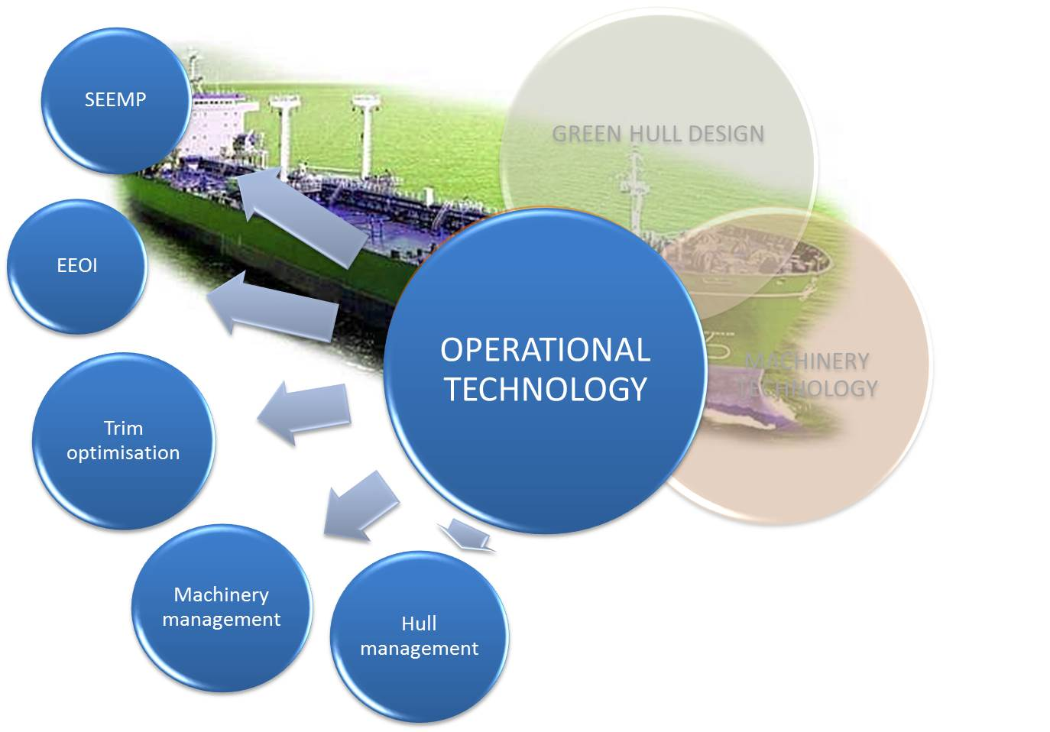
GREEN SHIP DESIGN AND TECHNOLOGY
MODULE STRUCTURE:
CHAPTER 3. OPERATIONAL TECHNOLOGIES
Ship energy efficiency management (SEEMP)
Energy efficient operational indicator (EEOI)
Hull condition management
Ship machinery management
Trim optimisation

Slide 9
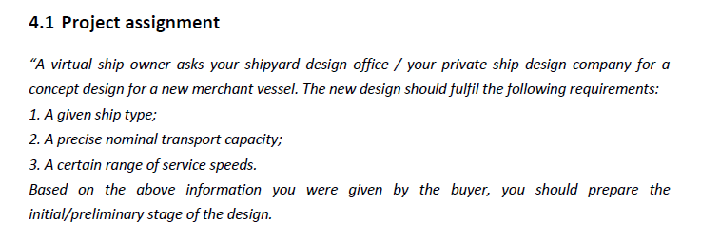
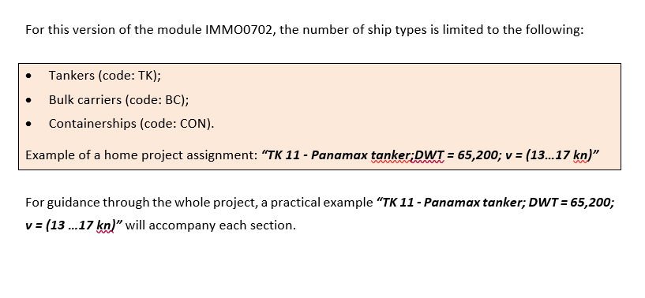
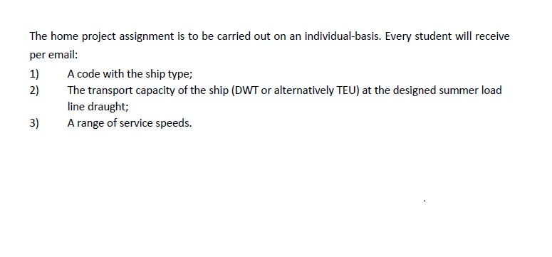
GREEN SHIP DESIGN AND TECHNOLOGY
INDIVIDUAL ASSIGNMENT:
PART 2. Practical application of concepts: CONCEPT DESIGN OF A PROJECT SHIP

Slide 10
GREEN SHIP DESIGN AND TECHNOLOGY
MODULE STRUCTURE:
PART 2. Practical application of concepts: CONCEPT DESIGN OF A PROJECT SHIP
2.1. Estimation of dimensions, ratios and form coefficients
2.2. Evaluation of project ship‘s initial stability
2.3. Visualisation of the project ship hull form
2.4. Computation of weights
Internet access required
2.5. Selection of propulsion machinery and aux. power
2.6. Design examination regarding the EEDI

Slide 11
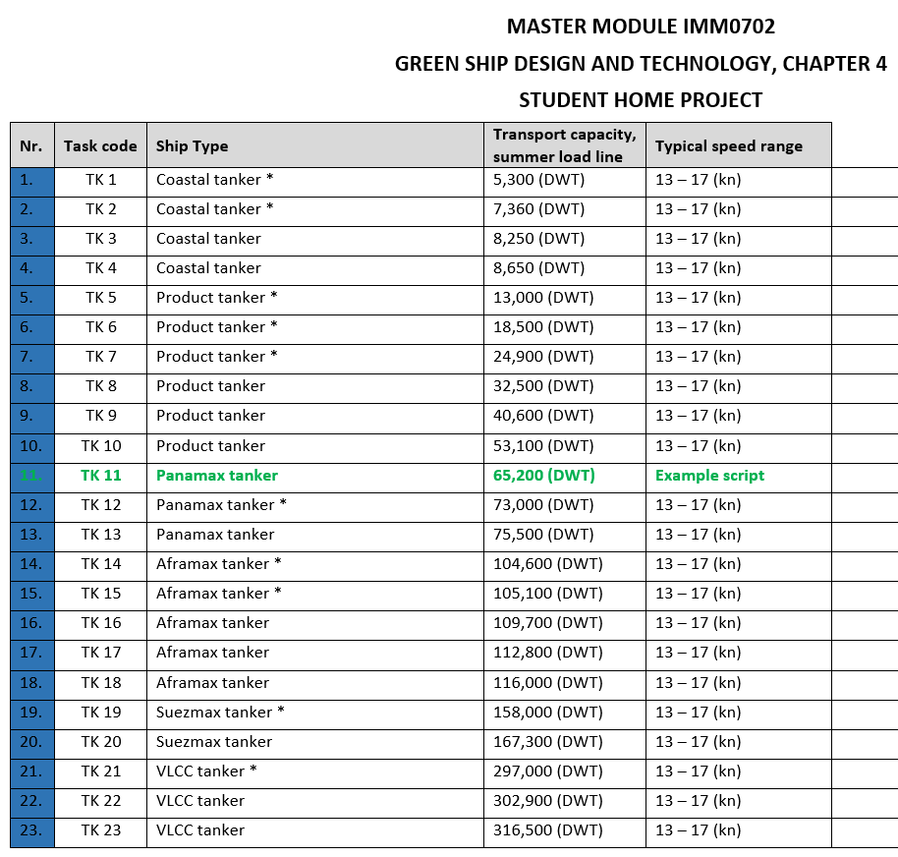
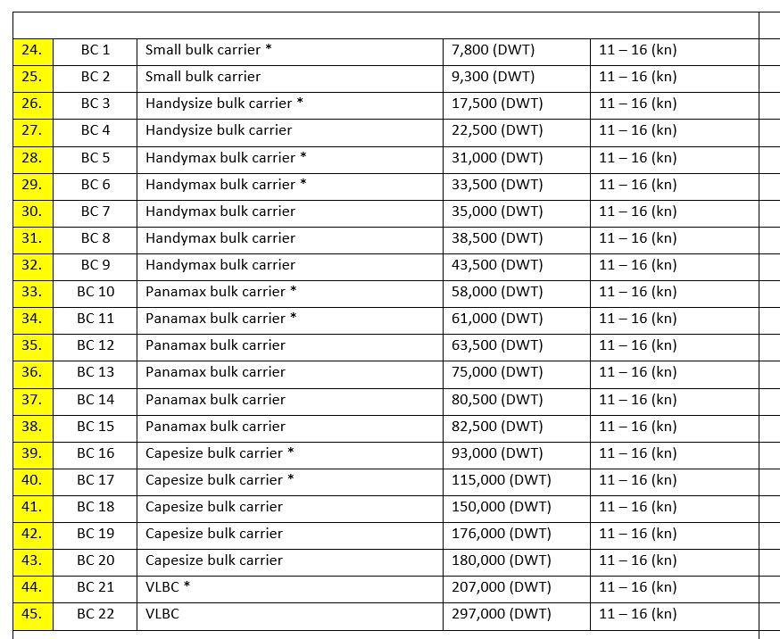
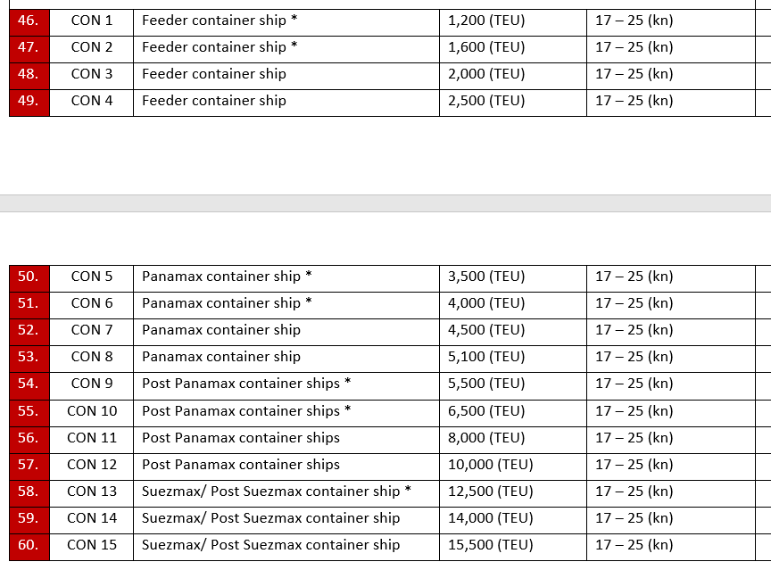
GREEN SHIP DESIGN AND TECHNOLOGY
INDIVIDUAL ASSIGNMENT:
PART 2. Practical application of concepts: CONCEPT DESIGN OF A PROJECT SHIP

Slide 12
GREEN SHIP DESIGN AND TECHNOLOGY
INDIVIDUAL ASSIGNMENT:
You are required to submit the following home project results until 20. February 2019:
One spreadsheet –file (*.xlsx or *. Pdf) with all calculations
Project ship output files:
1. Lines Drawing (*.dxf) and Table of Offsets (*.txt)
2. Perspective view of the hull (*.pdf)
3. Design hydrostatics report (*.pdf)
As an example:

Slide 13
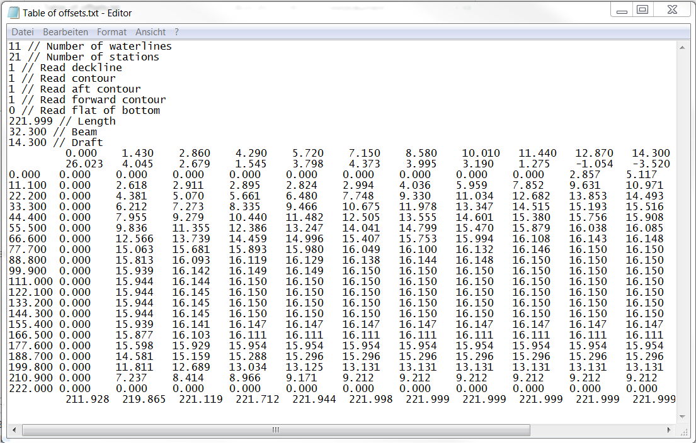
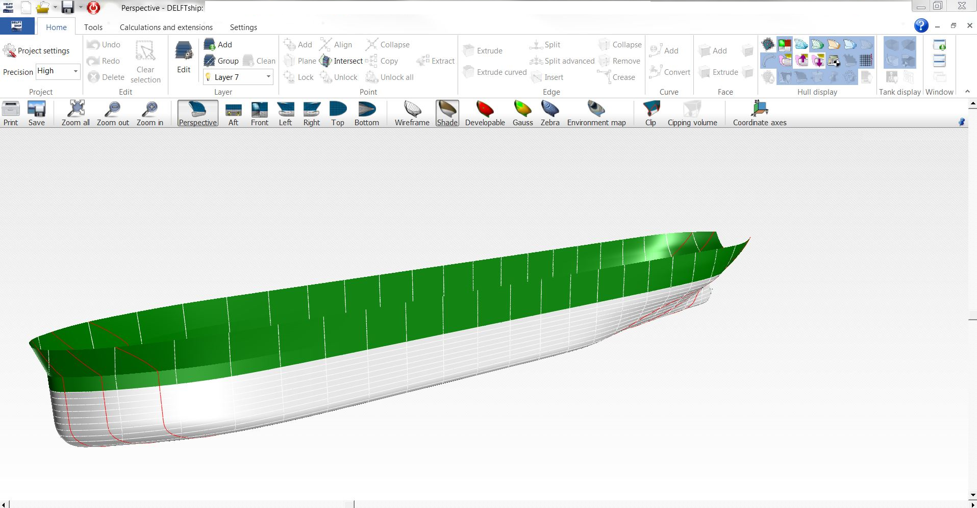
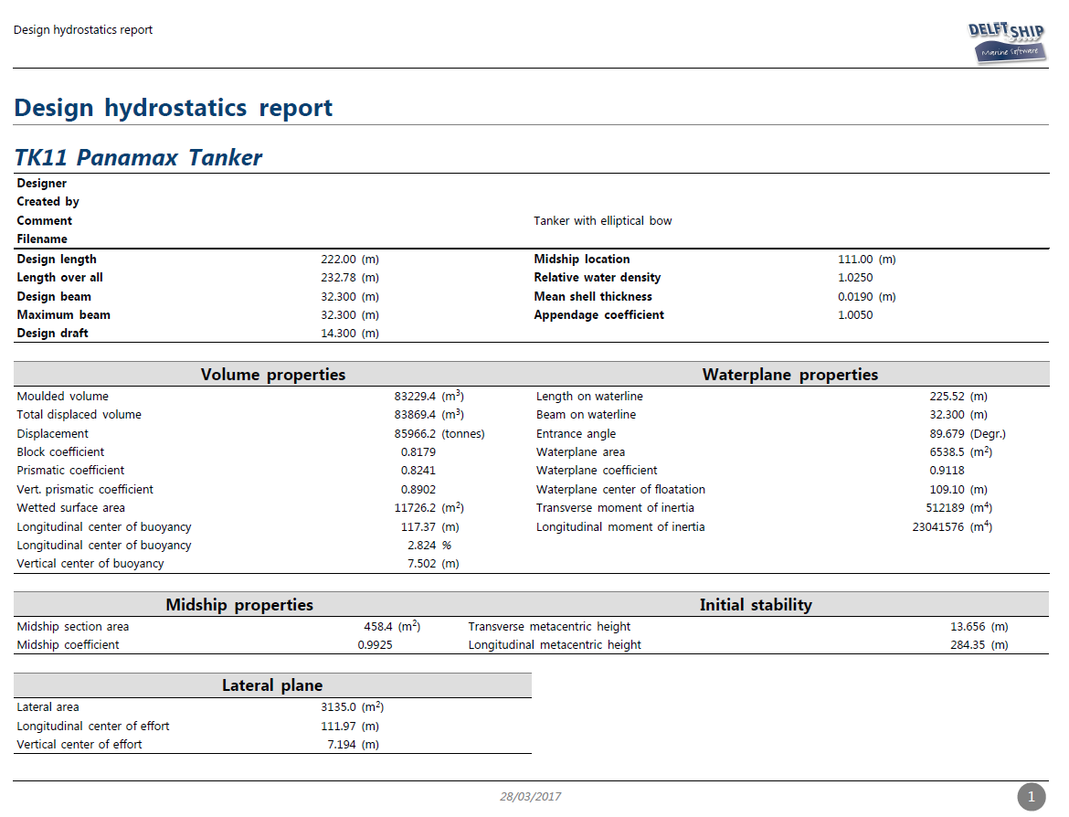
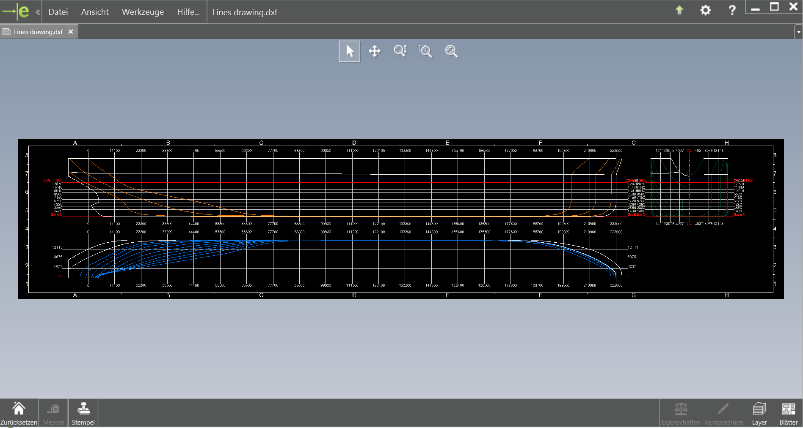
GREEN SHIP DESIGN AND TECHNOLOGY
EXAMPLE HOME PROJECT RESULTS:
1
2
3
1

Slide 14
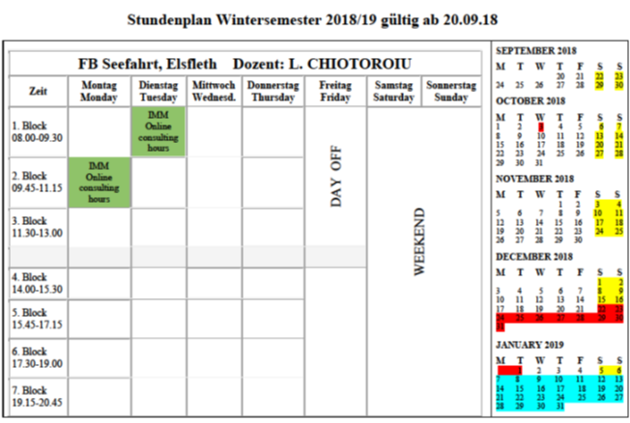
GREEN SHIP DESIGN AND TECHNOLOGY
SUPERVISION:
Consultation hours:
- MOODLE Forum
- E-mail: laurentiu.chiotoroiu@jade-hs.de

Slide 15
DISCUSSION / QUESTIONS ?
Good luck
and enjoy your time studying the GSDT module!
Thank you for your attention !

